Slide 1

Radiomics approach to predict responses to radio-immunotherapy combinations
Roger SUN, MD PhD
Radiotherapy
Gustave Roussy Cancer Campus
Villejuif, France

Slide 2
Conflict of interests
None
Notes:
there is substantial evidence that radiotherapy induces immune stimulation at the local and systemic levels, through the release of tumor antigens and pro-inflammatory cytokines
may thus act synergistically with immunotherapy in the systemic control of advanced cancers
Irradiation modalities to optimize the achievement of a systemic anti-tumor immune response are subject of numerous studies

Slide 3
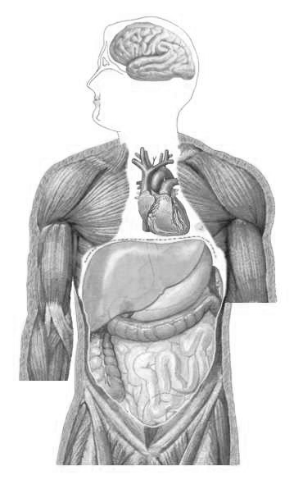
Radioimmunotherapy
« Abscopal » effect
Radiotherapy
Optimization?
RT
X
X
Immunotherapy
Notes:
there is substantial evidence that r
radiotherapy induces immune stimulation at the local and systemic levels, through the release of tumor antigens and pro-inflammatory cytokines
also promotes immunosuppressive effects, with notably a PD-L1 upregulation
may thus act synergistically with immunotherapy in the systemic control of advanced cancers
Irradiation modalities to optimize the achievement of a systemic anti-tumor immune response are subject of numerous studies

Slide 4
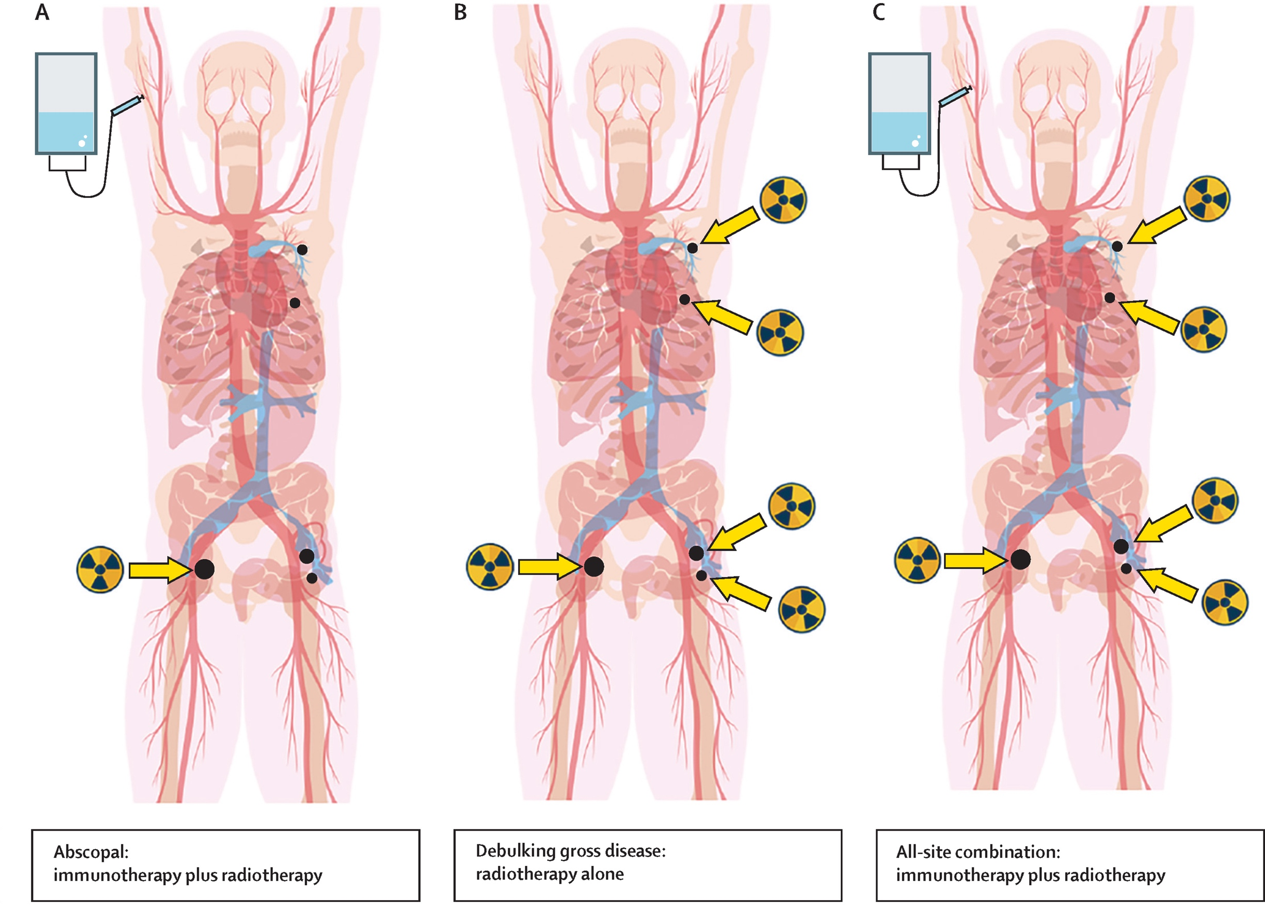
Radioimmunotherapy
Radiotherapy
Dose
Optimization?
Number of targets
Choice of targets
Immunotherapy
Deutsch et al. Lancet Oncol 2019
Notes:
there is substantial evidence that radiotherapy induces immune stimulation at the local and systemic levels, through the release of tumor antigens and pro-inflammatory cytokines
may thus act synergistically with immunotherapy in the systemic control of advanced cancers
Irradiation modalities to optimize the systemic anti-tumor immune response are subject of numerous studies
Open questions remain pending , such as the number and choice of lesions to irradiate

Slide 5
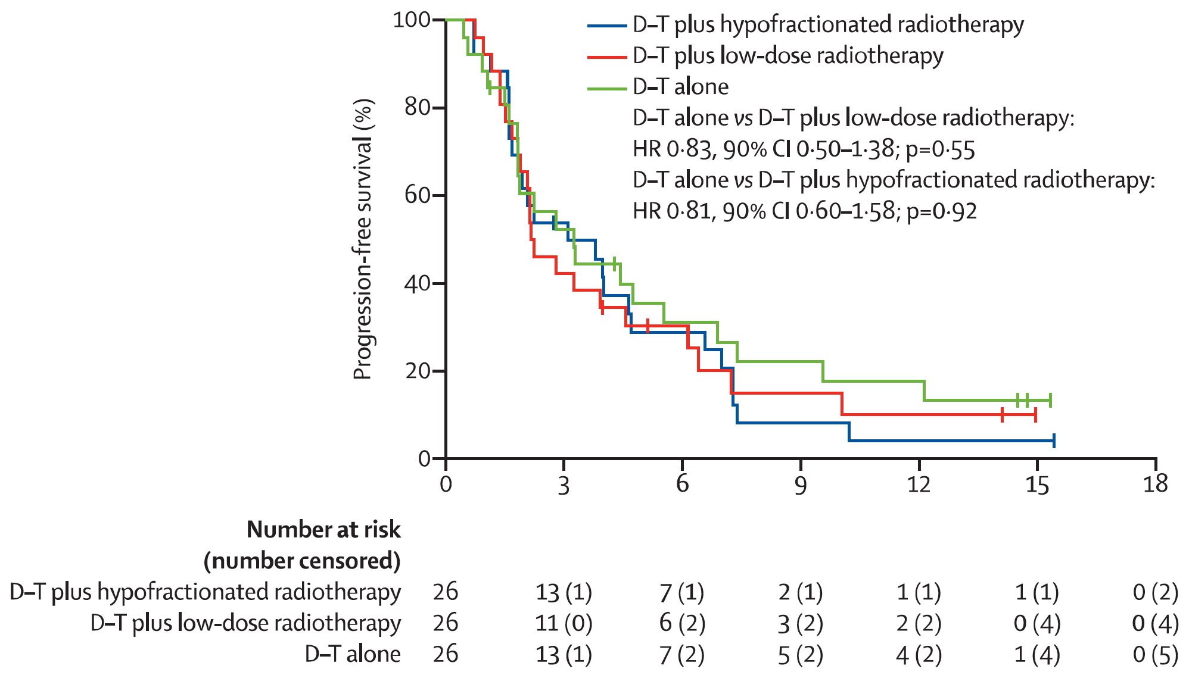
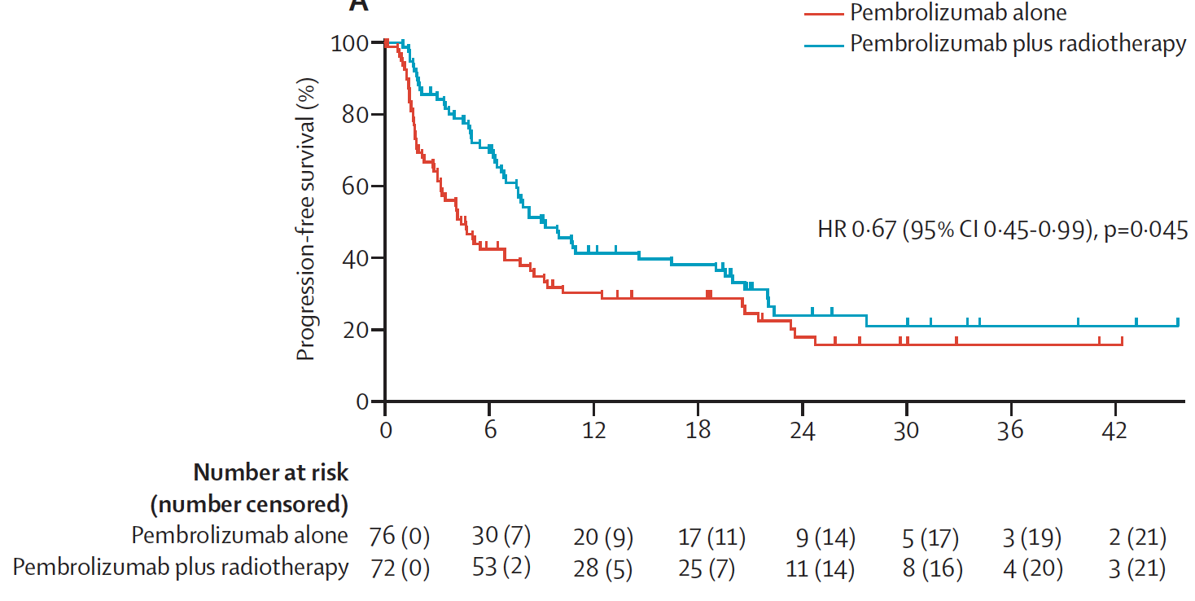
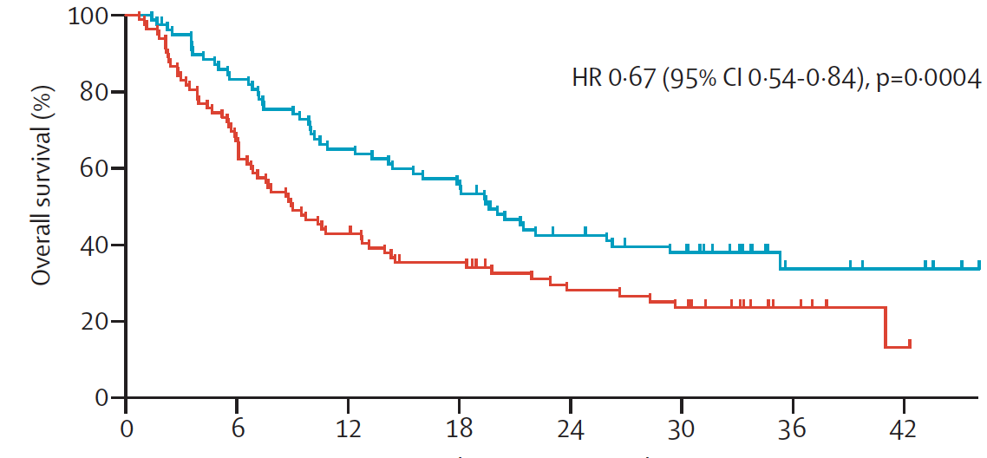
Radioimmunotherapy
Mitigated results
Radiotherapy
Dose
Optimization?
Lung cancers
PFS
Number of targets
Schoenfeled et al.
Lancet Oncol 2022
Spatial heterogeneity:
Medical imaging
& AI ?
Choice of targets
PFS
OS
Immunotherapy
Theelen et al. Lancet Oncol 2022
Notes:
Open questions such as the number and choice of lesions to irradiate remain pending
These parameters may explain the mitigated results of some randomized clinical trials of radioimmunotherapy combination.
it is likely that the key to define these parameters
is the evaluation of the spatial heterogeneity of the disease, and that imaging and AI would particularly allow to analyze it.
it is likely that AI will have a central role

Slide 6
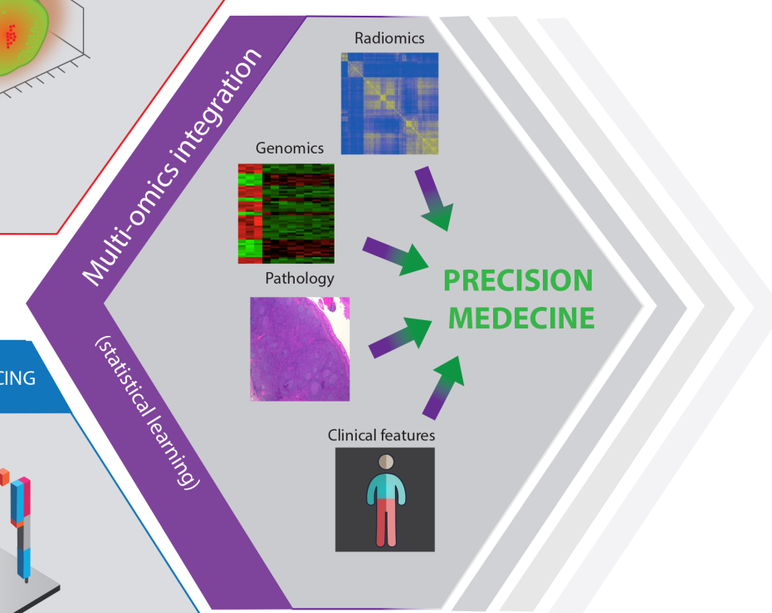
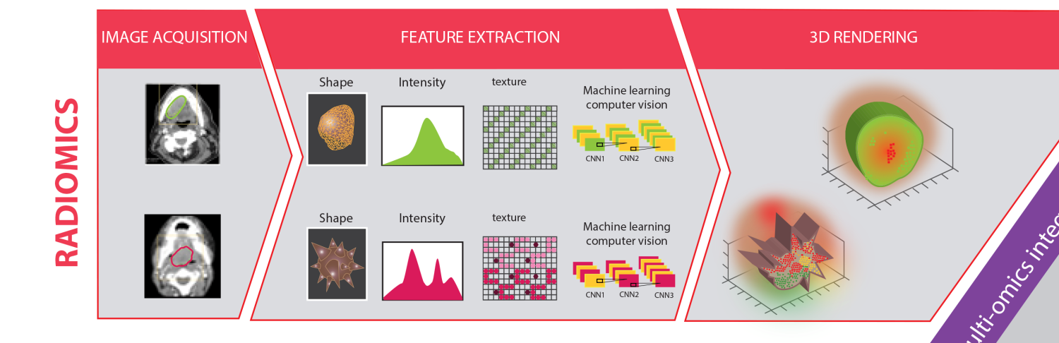
Radiomics
Translates medical imaging into quantitative data
Reflects the tumor phenotype (cellular and molecular properties)
AI approaches: development of imaging biomarkers
Limkin E, Sun R et al. Ann Oncol 2017

Slide 7
Radiomics and immunotherapy
Molecular pathways of immune response, inflammation, TILS, PD-L1
Grossman et al. eLife 2017
Tang et al. Sci Rep 2018
Chen et al. Eur Radiol 2019
MSI: Golia Pernicka et al. Abdom Radiol 2019
Microenvironment > IO response
CD8: Sun et al. Lancet oncol 2018
TMB: He et al. J Immunother Cancer. 2020
PDL1: Mu et al. J Immunother Cancer. 2021
Hypoxia: Tunali et al. JNCI Cancer Spectr. 2021
Response to IO directly
Tunali et al. Lung Cancer 2019
Trebeshi et al. Ann oncol 2019
Khorrami et al. Cancer Immunol Res 2019
Mu et al. EJNMMI 2020
Liu et al. Front Oncol 2021
MDSC-targeting immunotherapy : Devkota Sci Adv. 2020 (mice)
Notes:
There is a growing interest in using radiomics to predict response to immunotherapy.

Slide 8
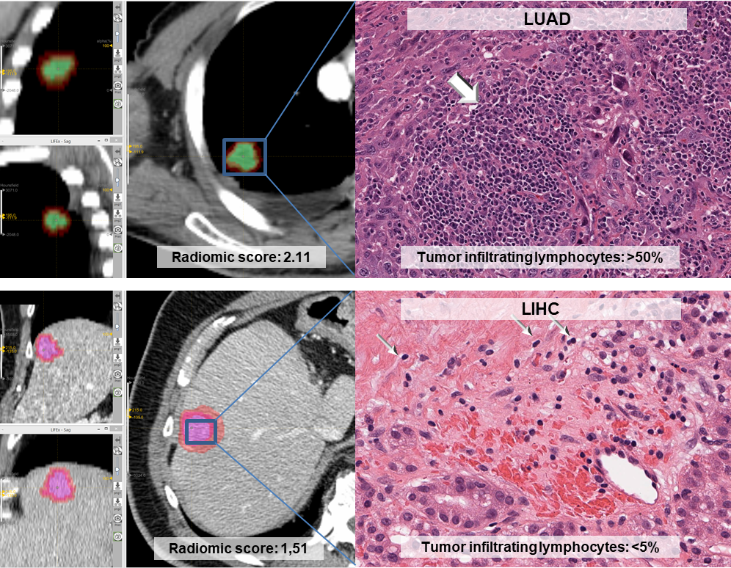
CD8 Radiomics signature
Prediction of CD8 T cells using radiomics on contrast enhanced CTs
Sun R, et al – Lancet Oncol 2018
27/09/2022
8
Notes:
BLCA, bladder cancer
LIHC, liver hepatocellular carcinoma
LUAD, lung adenocarcinoma
LUSC lung squamous cell carcinoma

Slide 9
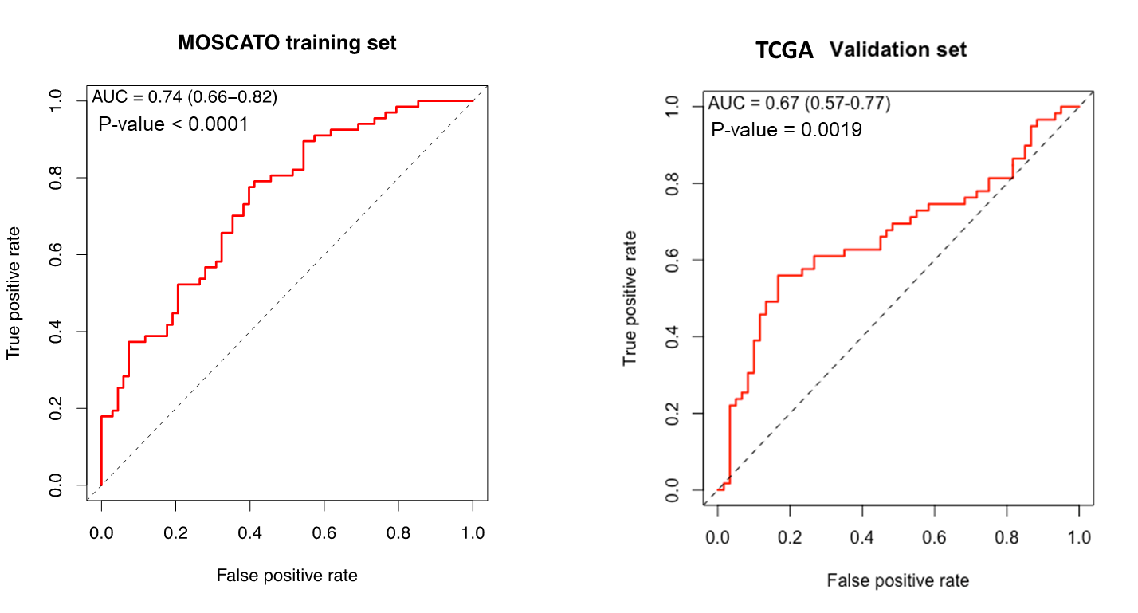
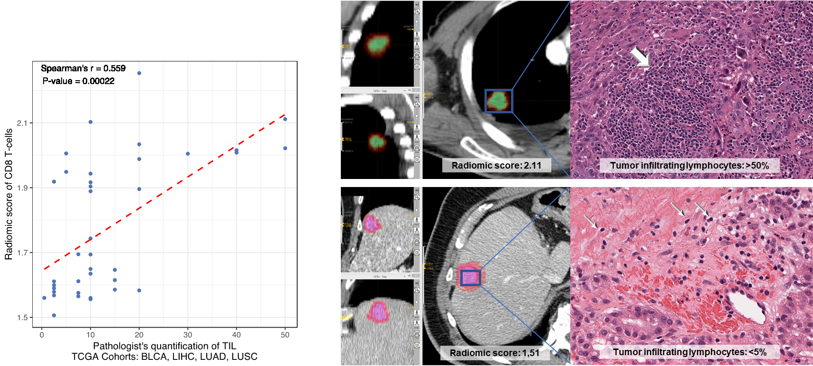
Introduction
CD8 Radiomics signature
The radiomic signature could discriminate high vs low genomic score of CD8 T-cells infiltration
N=135 pts
N=119 pts
And was associated with OS in patients treated with anti-PD-1/PD-L1
N=137 pts
Sun R et al. Lancet Oncol 2018
27/09/2022
9

Slide 10

Useful for radioimmunotherapy?
Patients
94 patients
100 irradiated lesions
189 non-irradiated lesions
Sun et al. JITC 2020
28/09/2022
10
Notes:
Sam Gross

Slide 11
RTIO cohort
Patient patterns of response
1.00
P-value = 0.0011
0.75
Overall Survival
0.50
Patients’ Response
Uniform response
Stable
Mixed response
Uniform progression
0.25
0.00
0
4
8
12
16
20
24
28
Response
Stable
Mixed
Progression
Sun et al. JITC 2020
28/09/2022

Slide 12
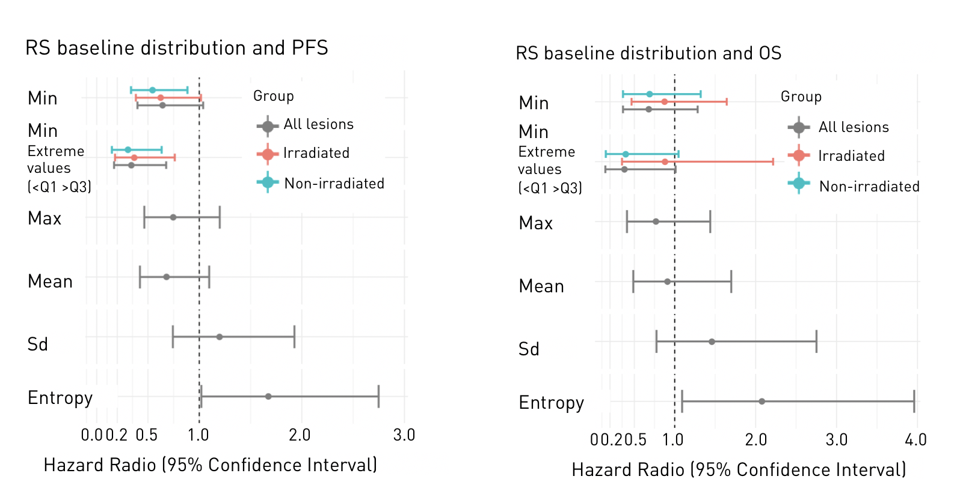
RTIO cohort
CD8 radiomic score distribution
Lesion response
Patient response
High CD8
Low CD8
Low
Moderate
High
Entropy
12
27/09/2022
12

Slide 13
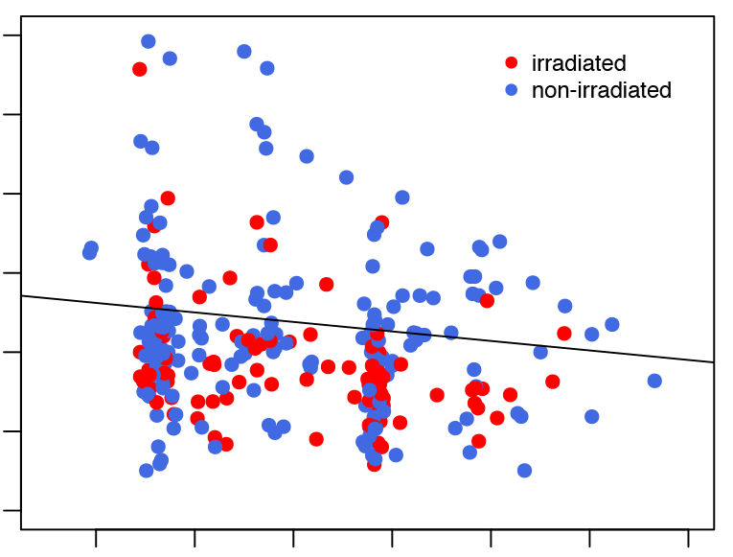
RTIO cohort
CD8 radiomic score distribution
Lesion response
Patient response
RECIST
changes (%)
Rho = - 0.19
P-value = 0.0017
200
Irradiated
150
Non- irradiated
100
50
0
-50
100
1.4
1.6
1.8
2.0
2.2
2.4
2.6
Baseline radiomics score of
CD8 T cells
Sun et al. JITC 2020
13
27/09/2022
13

Slide 14
RTIO cohort
CD8 radiomic score distribution
Patient response
Min CD8 RScore
Predictive value of
the least immune-infiltrated
and non-irradiated
metastasis
May help to guide radiotherapy
Sun et al. JITC 2020
14
27/09/2022
14

Slide 15
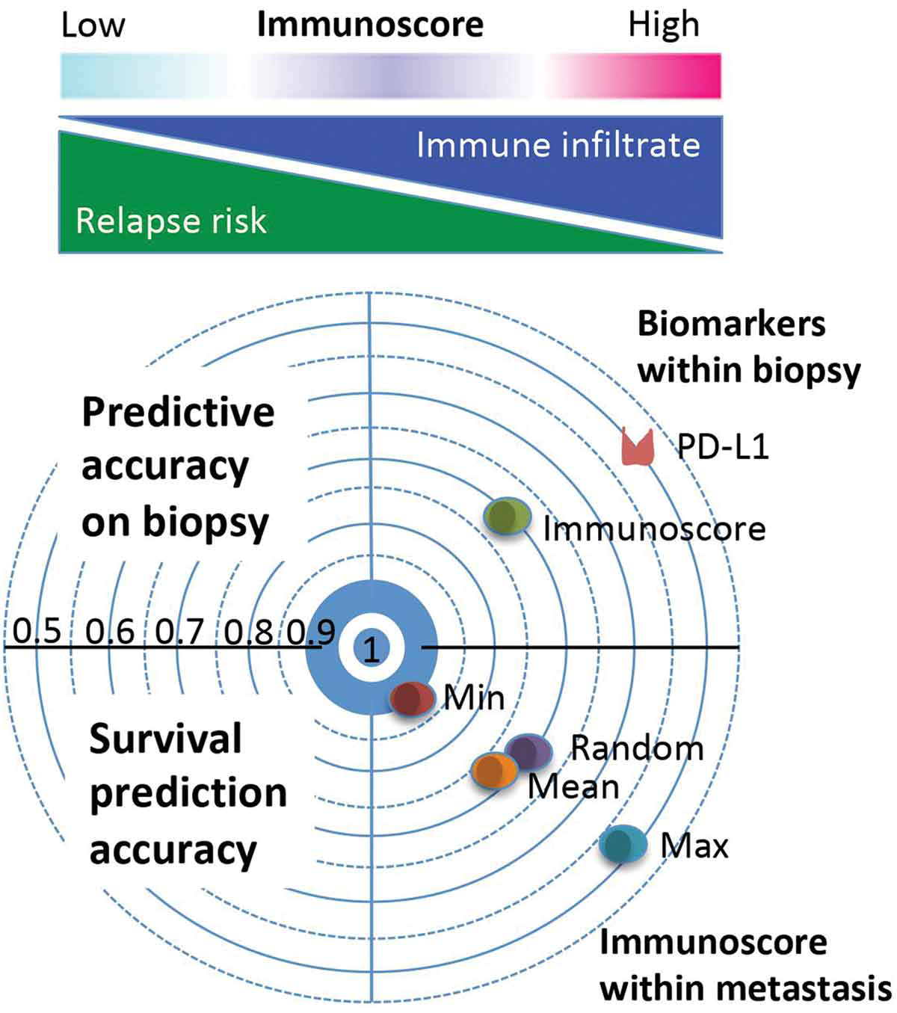
RTIO cohort
CD8 radiomic score distribution
Patient response
Van den Eynde et al. Oncoimmunology 2020
15
27/09/2022
15
Notes:
The Immunoscore is an immunohistochemistry and digital pathology-based scoring system assessing the densities of two lymphocyte populations.

Slide 16
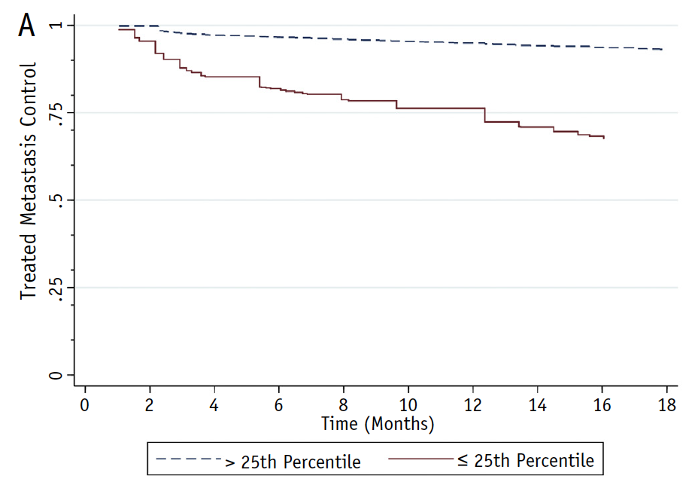
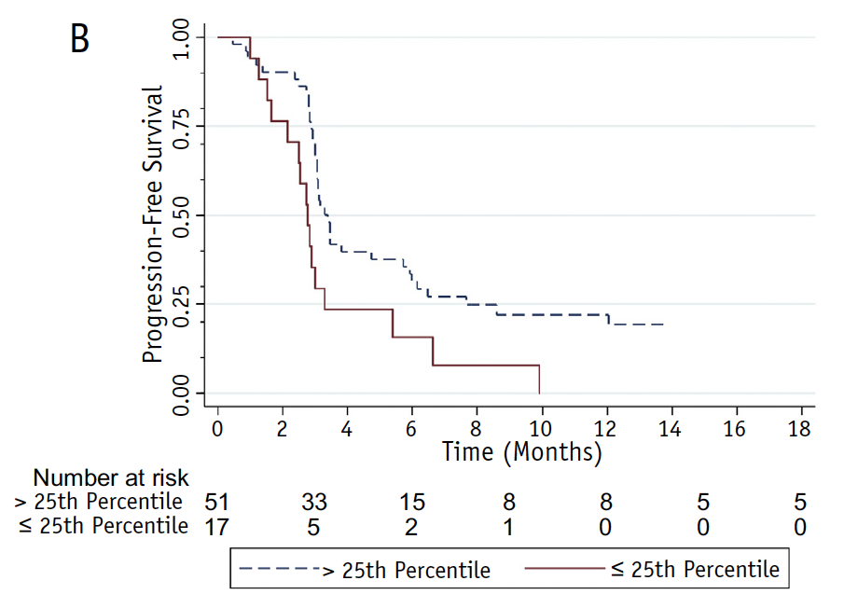
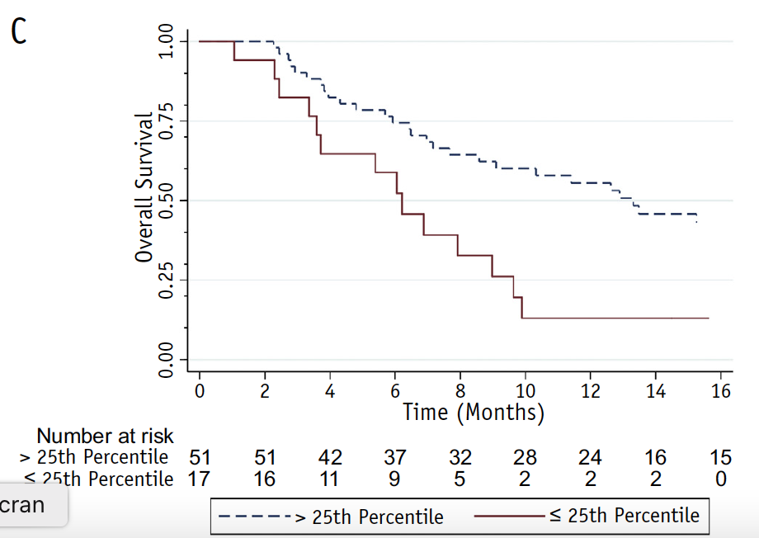
RTIO cohort
CD8 radiomic score external validation
Multi-site SBRT Combined with Pembrolizumab
68 patients
139 metastases
OS
PFS
Local control
Korpics et al. IJROBP 2020
16
28/09/2022
16

Slide 17
Toward ultra-precision radioimmunotherapy ?
Imaging-biomarkers guided radiotherapy
Sun R et al JITC 2022

Slide 18

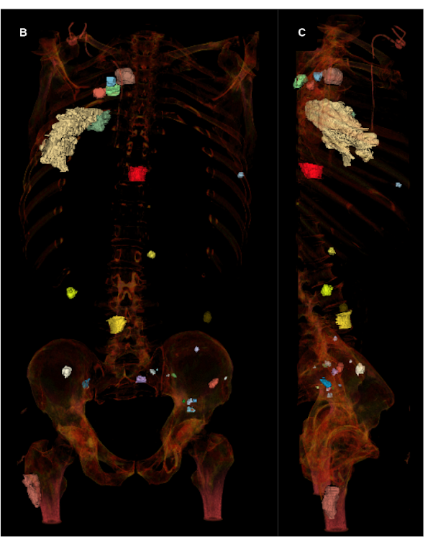
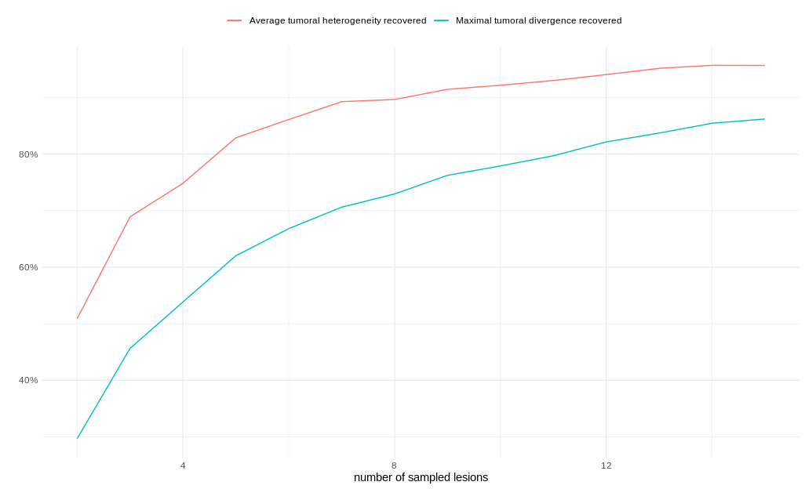
Challenges
Spatial heterogeneity assessment
80%
60%
40%
4
8
12
Number of sampled lesions
Henry T et al. scientific report 2022

Slide 19
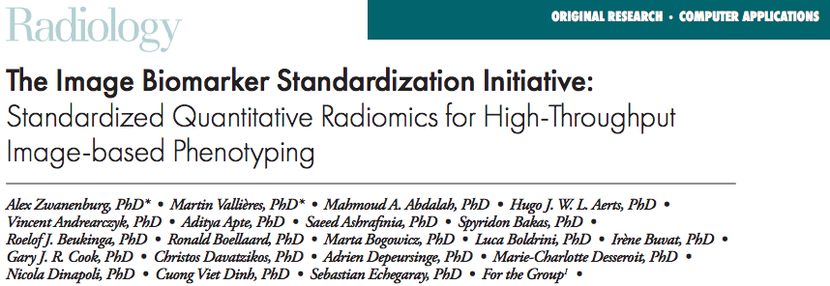
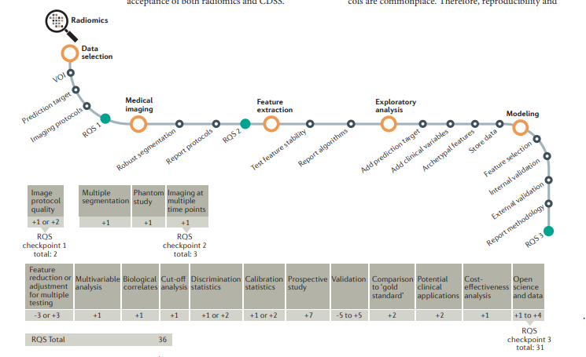
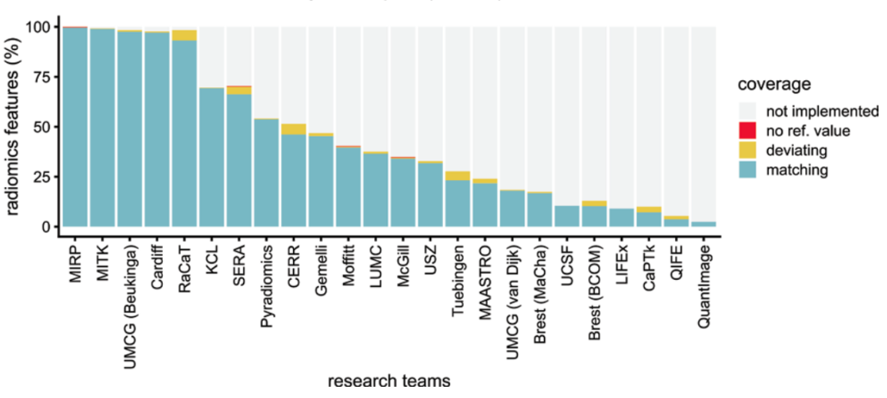
Validity of radiomics studies
Radiomics Quality Score
Lambin et al, NRCO 2017
Zwanenburg A et al. Radiology 2020

Slide 20
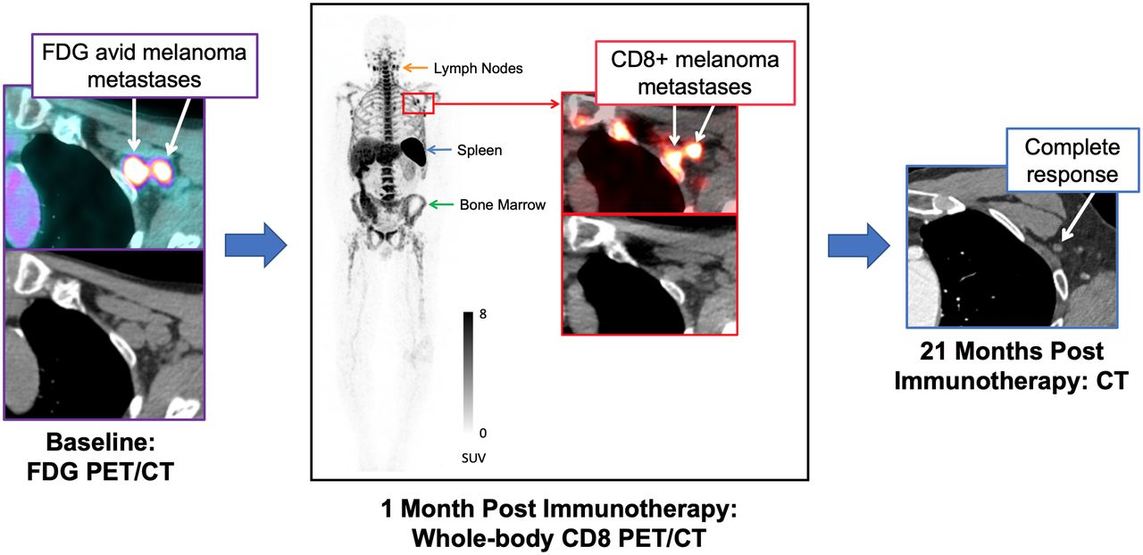
Challenges / Opportunities
Immuno-PET imaging ?
⁸⁹Zr-Df-IAB22M2C
Radiolabeled Anti-CD8 Minibody
Farwell et al JNM 2022
Notes:
Tracers specifically directed against the CD8 T cells
However, these approaches do have limitations such as the difficult access to the tracers that may impact the repeatability of these exams, the need for standardization to allow reproducibility, and the need to take into account the tracer biological distribution, especially in certain normal lymphoid tissues such as spleen and nodes

Slide 21
Conclusions
Heterogeneity is a major challenge for radiomics studies
Improve knowledge: tumor biology & radioimmunotherapy
Non-invasive way for selection of radiotherapy targets
Importance of appropriate radiomics study design
27/09/2022
Notes:
Heterogeneity is not sufficiently evaluated in studies

Slide 22

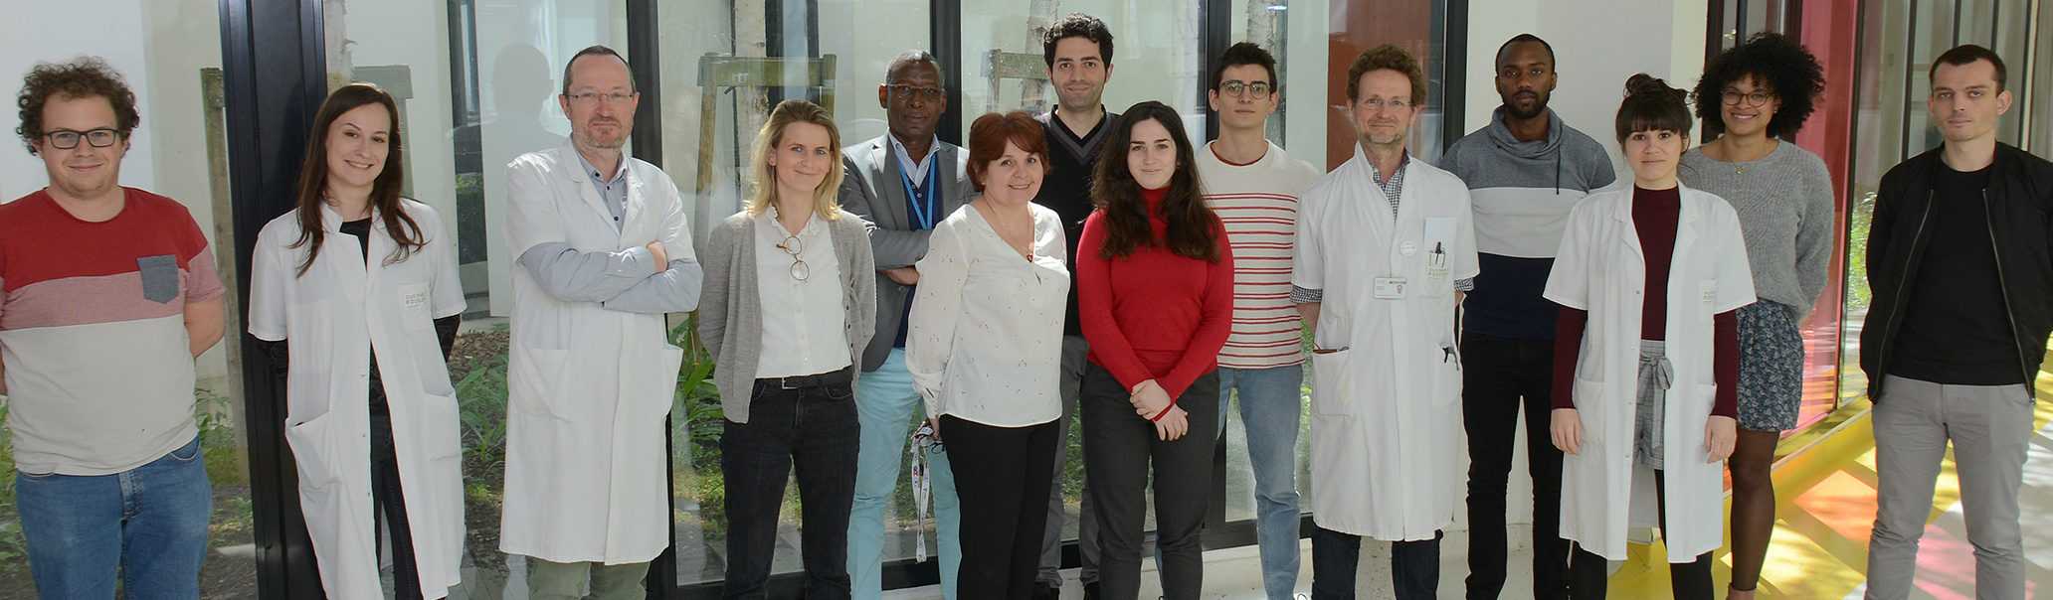

U1030 and collaborations
Thank you for your attention !
Parma university
Dr Giulia Mazzaschi
Pr. Éric DEUTSCH (PU-PH)
Researchers
Dr. Charlotte ROBERT (MCU)
Dr. Maria VAKALOPOULOU (MCU)
Ibrahima DIALLO (IR)
Cristina VERES (IR)
Post-doc
Dr. Rahimeh ROUHI (Gustave Roussy)
CentraleSupélec / Therapanacea
Pr. Nikos Paragios
Ghent university
Pr. Piet Ost
Dr. Nora Sundahl
Dr. Mathieu Spaas
Erlangen Strahlenklinik
Pr. Rainer Fietkau
Dr. Udo Gaipl
Dr. Markus Hecht
Fondazione IRCCS Policlinico San Matteo di Pavia
Pr. Andrea Filippi
Dr Andrea Lancia
PhD students
Nathan BENZAZON
Théophraste HENRY (MD)
Marvin LEROUSSEAU
Amaury LEROY (Therapanacea, Gustave Roussy)
Sonia MARTINOT (Therapanacea, Gustave Roussy, Centrale Supélec)
Stéphane NIYOTEKA (Doctorant)
François DE KERMENGUY (Paris Saclay)
Chef de projet
Vjona CIFLIKU
roger.sun@gustaveroussy.fr
rgrsun
28/09/2022
22

Slide 23
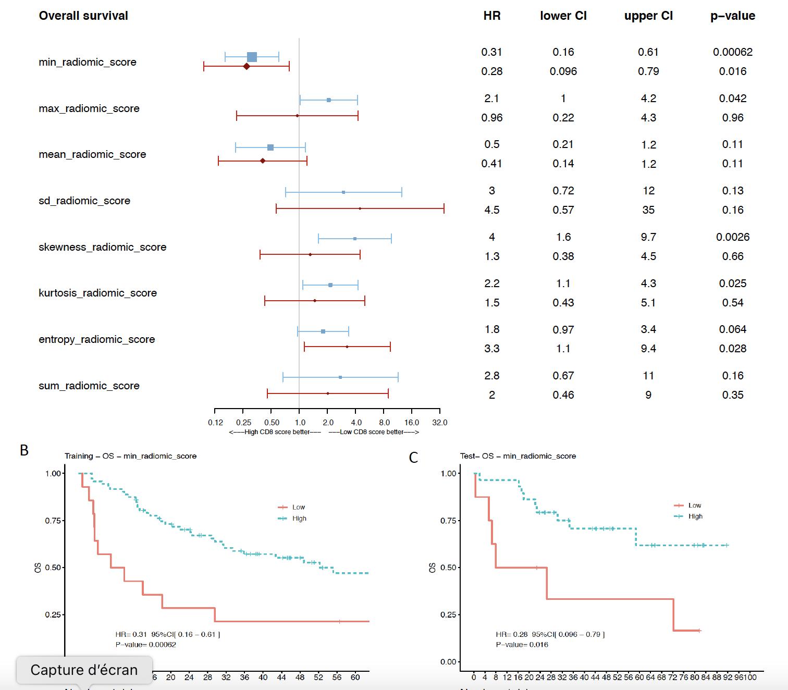
Melanoma
CD8 radiomics score
136 patients
Submitted (minor revision JITC)
DO NOT POST

