Slide 1

Hipertermia y Nanopartículas en Oncología:
Experiencias clínicas y proyectos en marcha
Dr. Jorge Contreras
H. Regional de Málaga
Centro Integral de Oncología (CIO)
QuironSalud Málaga-Costa del Sol
Spanish Hyperthermia Group Coordinator (SEOR)
Notes:
1

Slide 2
AGENDA
Hyperthermia in oncology

Slide 3
HYPERTHERMIA
What´s Hyperthermia?
“Elevation of temperature above the physiological level with the objective to achive a therapeutic gain in cancer patients”
Notes:
3

Slide 4
HYPERTHERMIA
What is it?
Heat up tumors up to 41 ºC–45 ºC (106 ºF – 113 ºF)
Non ablative
Boosting therapy for CT/RT:
“So, it is also an unique oportunity to improve the results of the convencional cancer treatment (Surgery +/- Radiotherapy +/- Chemotherapy)”

Slide 5
HYPERTHERMIA
What it is not Hyperthermic Oncology?
“It is not alternative Medicine”
Although it has “per se”a citolitic effect, the best results are presented when combined with the conventional oncological treatment:
Surgery, Radiotherapy and/or Chemotherapy
Notes:
5

Slide 6
Methods of Hyperthermia (from National Cancer Inst)
 | Method | Site | Tumor
Local HT | External | Skin | Breast ca. recurrence
 | Intraluminal | Body cavities | Oesophagus, bladder
 | Interstitial | Brain or liver | GBM, HCC
Regional HT | Deep HT | Abdominal cancer | Cervix, rectum, pancreas, sarcoma
 | Regional perfusion | Arm or legs | Melanoma, sarcoma
 | CHPP | Peritoneal cavity | Ovarian cancer
Whole body HT |  | Whole body | Metastatic cancer

Slide 7
Methods of Hyperthermia (from National Cancer Inst)
 | Method | Site | Tumor
Local HT | External | Skin | Breast ca. recurrence
 | Intraluminal | Body cavities | Oesophagus, bladder
 | Interstitial | Brain or liver | GBM, HCC
Regional HT | Deep HT | Abdominal cancer | Cervix, rectum, pancreas, sarcoma
 | Regional perfusion | Arm or legs | Melanoma, sarcoma
 | CHPP | Peritoneal cavity | Ovarian cancer
Whole body HT |  | Whole body | Metastatic cancer

Slide 8
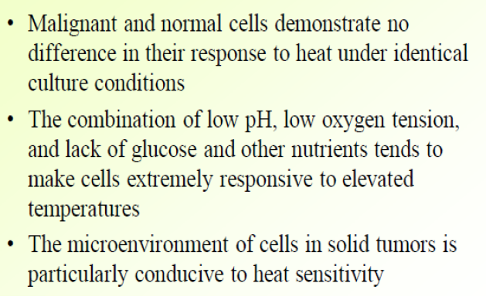
HYPERTHERMIA

Slide 9
Plethoria of biological effects due to local hyperthermia of the tumour
Van den Tempel et al. Int. J. Hyperthermia 2016
Notes:
Biological effects of local hyperthermia in the tumour. A tumour, represented by the pictogram in the centre, and the diverse physiological and molecular effects of heat are indicated.
(A) Hyperthermia alters physiology of the centrally located tumour by affecting its vasculature: heat increases the blood flow and vessel permeability. (B) Heat causes proteins to unfold and increases the intracellular amount of protein-chaperoning heat-shock proteins. (C) Temperatures exceeding 37 C result in increased cell membrane fluidity, thereby influencing their permeability. Specific biological effects of heat on membranes may be further affected by altering properties of membrane-bound-proteins. (D) Local heat helps to activate the immune system and causes it to attack the tumour directly, but might also cause a systemic effect by which immune cells attack tumour cells distant from the heated tumour. (E) Hyperthermia affects DNA damage repair pathways by deactivating specific repair proteins.
9
Biological effects of local hyperthermia in the tumour. A tumour, represented by the pictogram in the centre, and the diverse physiological and molecular effects of heat are indicated.
(A) Hyperthermia alters physiology of the centrally located tumour by affecting its vasculature: heat increases the blood flow and vessel permeability. (B) Heat causes proteins to unfold and increases the intracellular amount of protein-chaperoning heat-shock proteins. (C) Temperatures exceeding 37 C result in increased cell membrane fluidity, thereby influencing their permeability. Specific biological effects of heat on membranes may be further affected by altering properties of membrane-bound-proteins. (D) Local heat helps to activate the immune system and causes it to attack the tumour directly, but might also cause a systemic effect by which immune cells attack tumour cells distant from the heated tumour. (E) Hyperthermia affects DNA damage repair pathways by deactivating specific repair proteins.

Slide 10
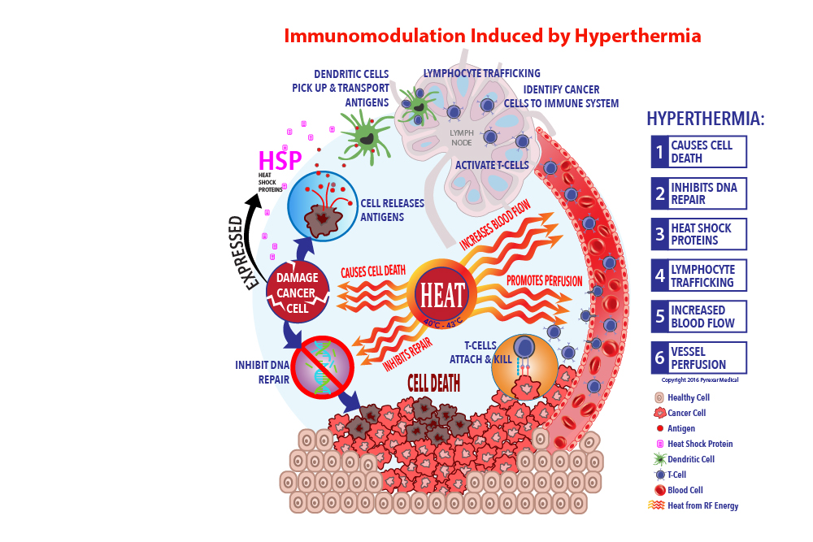
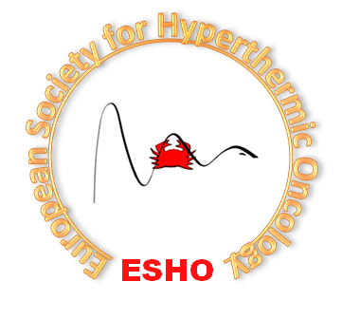

Slide 11
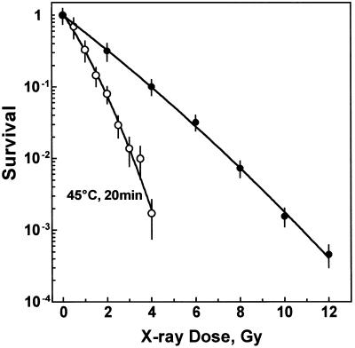
TER for Radiotherapy: 2.2
El-Awady 2001
Nucleid Acids Res 2001 May1;29(9):1960-66
Thermal enhancement ratio: 2.2
Notes:
11

Slide 12
TER for platin compounds: 1.5
10
-1
-2
-3
0 30 60 90 120 150
Treatment Time (min) at 37-44.5°
C
Thermal enhancement ratio: 1.5
Surviving Fraction
37°C
39°C
44.5°C
43°C
42°C
41°C
Notes:
12

Slide 13
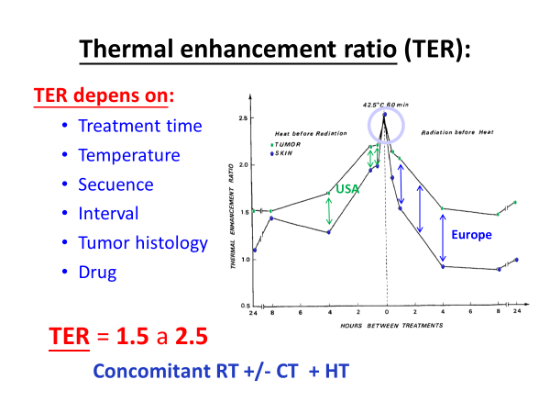
Overgaard Int J Rad Onc Biol Phys 6: 1507-1517 (1980)

Slide 14
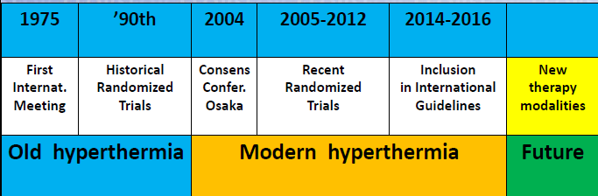
CLINICAL EVIDENCE
2020

Slide 15
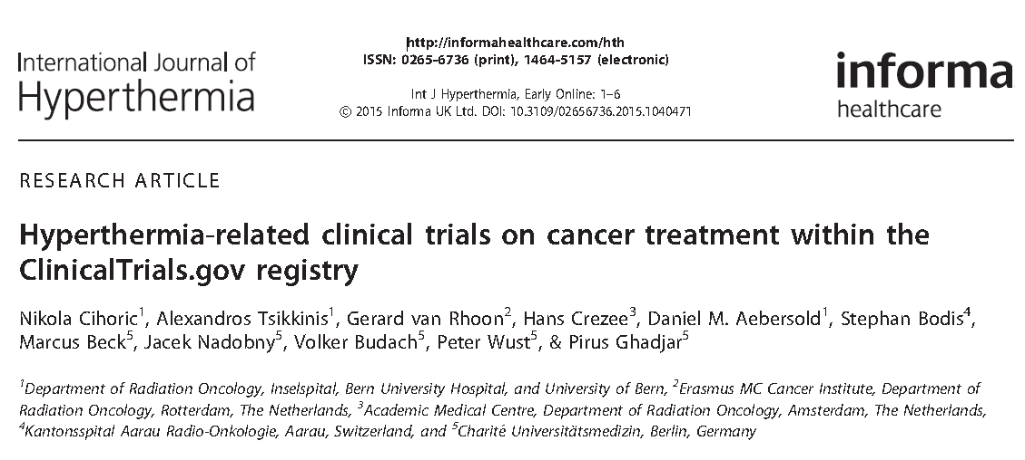


Slide 16
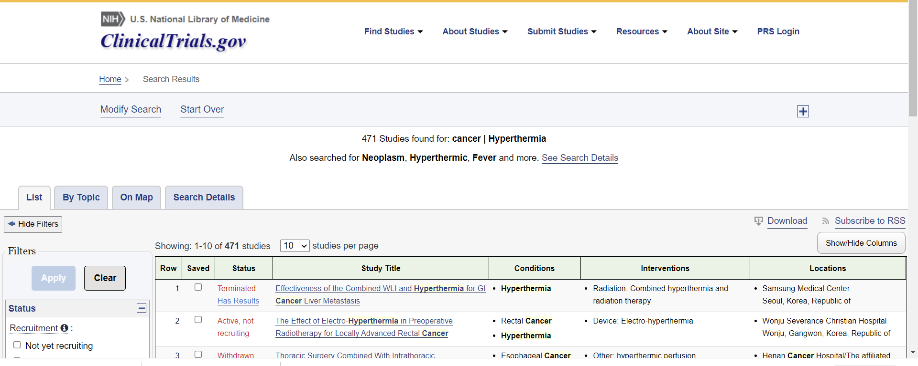
CLINICAL EVIDENCE
Notes:
Ponles el ejemplo del caso de los dos tumores y la CT

Slide 17
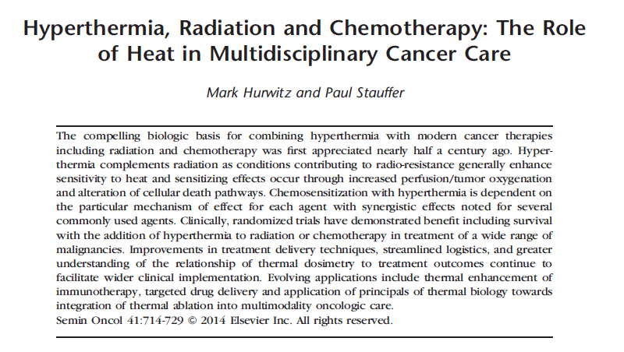
Notes:
17

Slide 18
Notes:
18

Slide 19
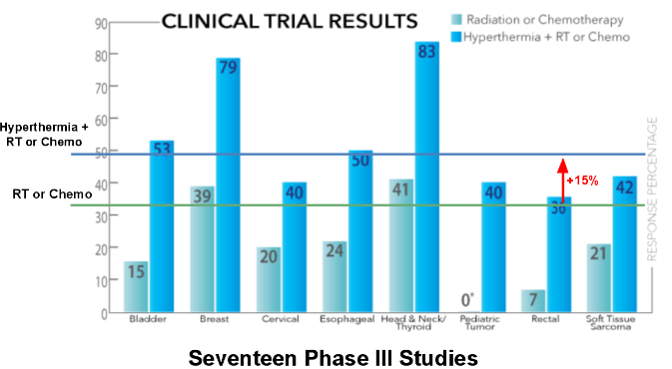
Notes:
Ponles el ejemplo del caso de los dos tumores y la CT

Slide 20
Clinical situations with high level
of evidence for using Hyperthermia:
Advanced and/or recurrent colo-rectal cancer
Advanced and/or recurrent breast cancer (including reirradiation)
Cervix cancer treated with RT +/- CT
Soft tissue sarcoma
Relapsed cutaneous tumors (including malignant melanoma)
Advanced Head and neck tumors
Central nervous system tumors (high grade astrocitomas) with Radiotherapy
Advanced and/or recurrent bladder tumors
Páncreas cancer
Etc

Slide 21
EQUIPMENTS
Notes:
21

Slide 22
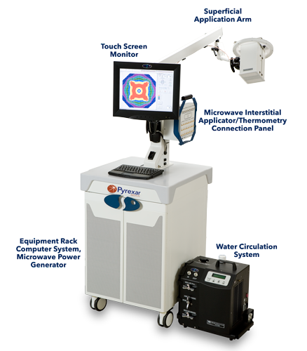
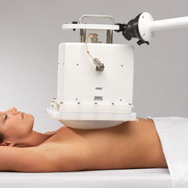
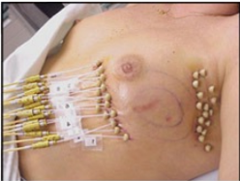
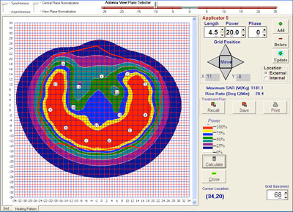
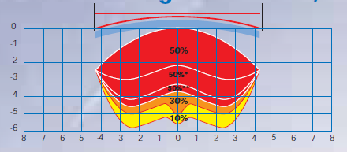
EQUIPMENTS

Slide 23
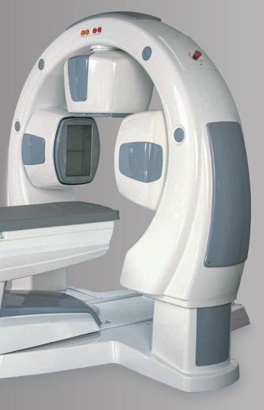

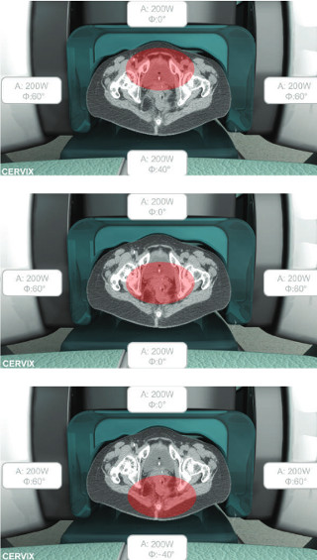
EQUIPMENTS
Notes:
23

Slide 24
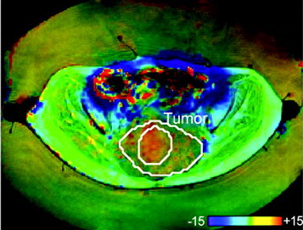
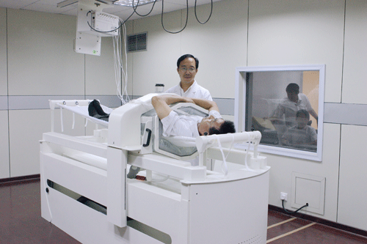
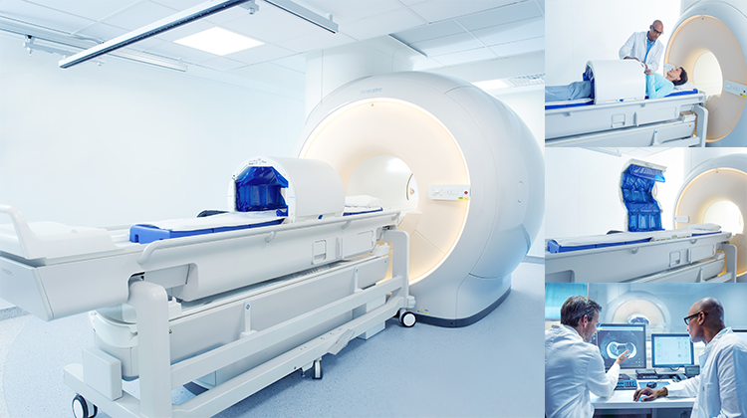
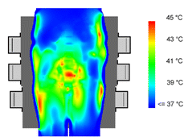
EQUIPMENTS

Slide 25
CLINICAL PRACTISE
Notes:
25

Slide 26
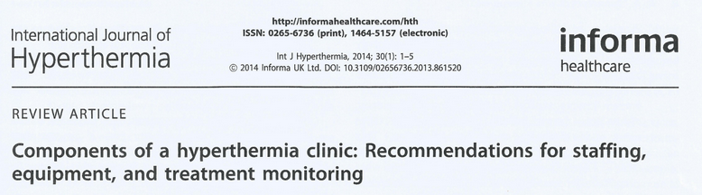
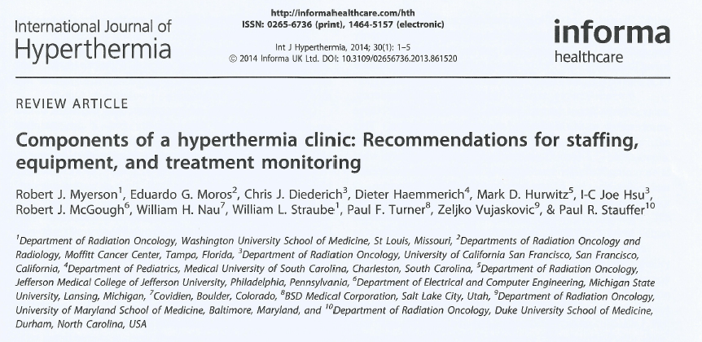
Onc. solicitante
Onc. Radioter
Radiofísica
DUE
Téc. Radioter

Slide 27
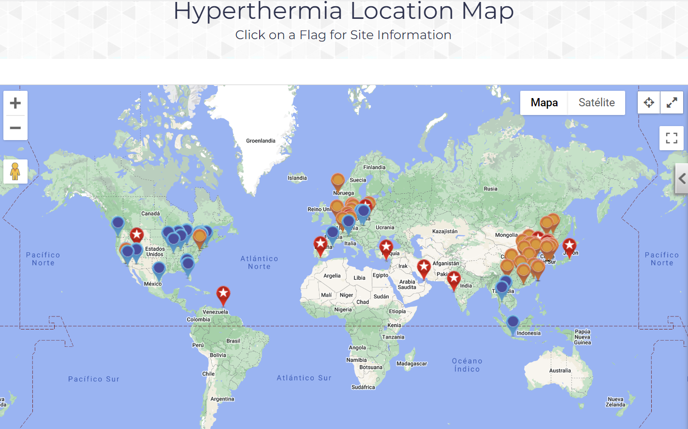
Hyperthermia around the world

Slide 28
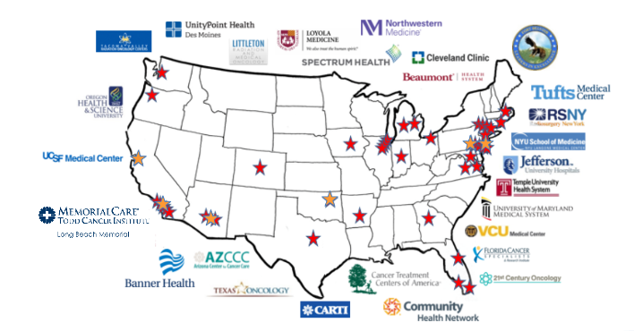
Hyperthermia around the world

Slide 29
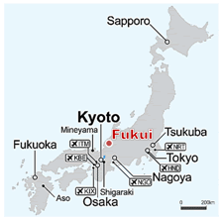
Hyperthermia around the world

Slide 30
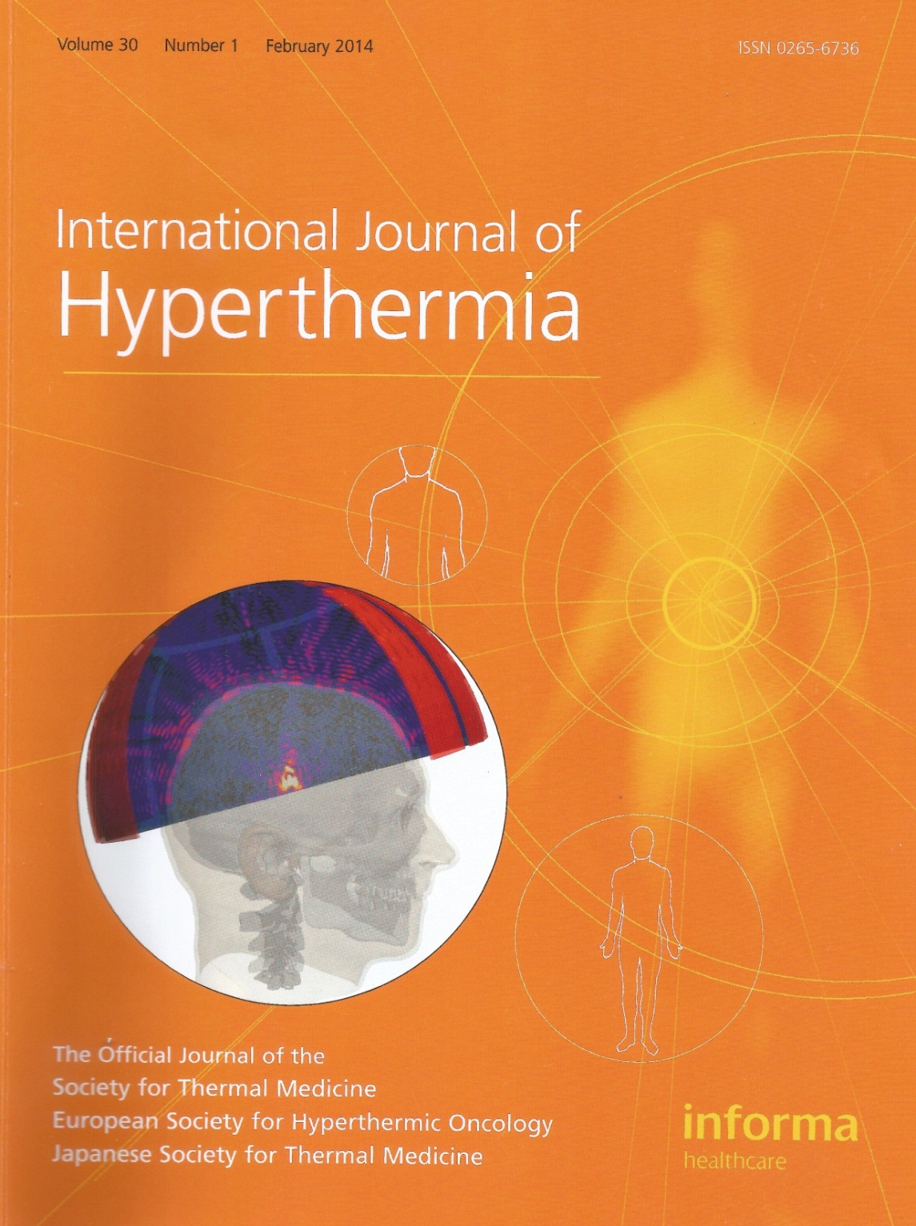
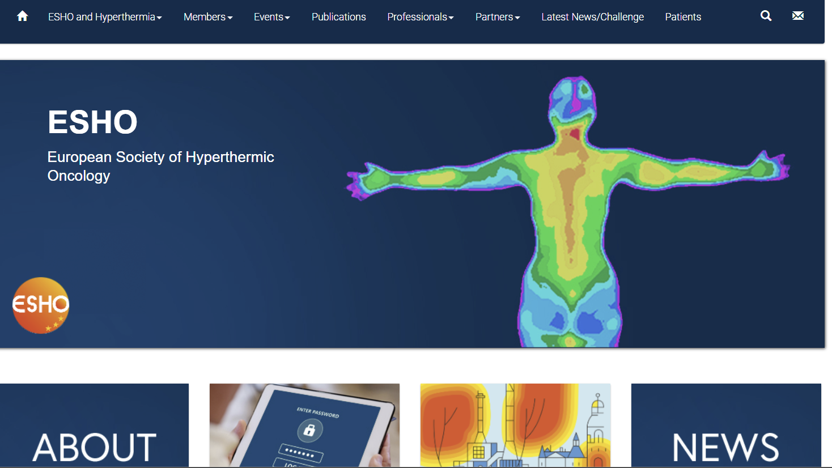
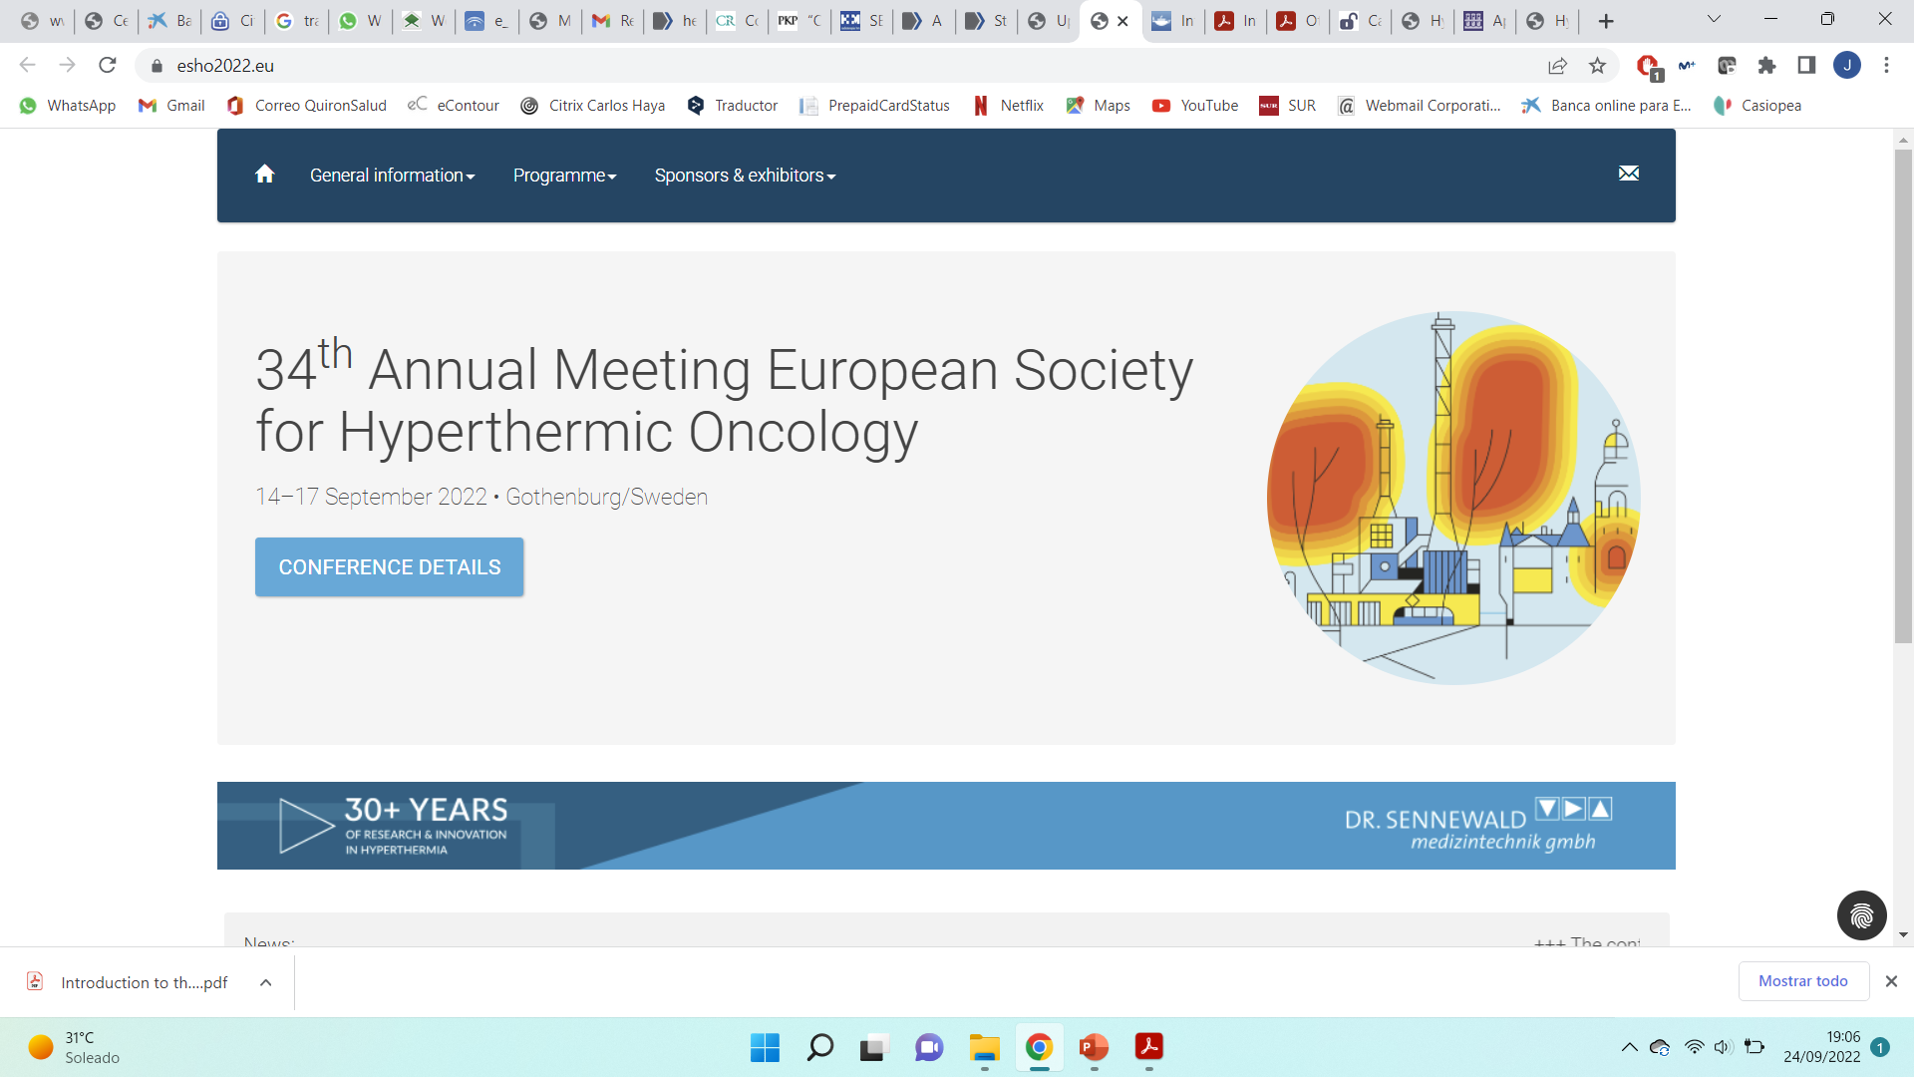
Hyperthermia around the world

Slide 31
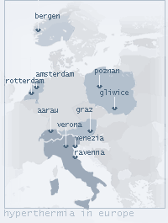
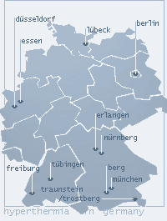
Hyperthermia around the world

Slide 32
REGION | N° centers | modalities | Total
Abruzzo | 1 | Private | 1
Campania | 2 3 | Public private | 5
Lazio | 2 1 4 | Public Public agreement private | 7
Liguria | 1 | Private | 1
Lombardia | 3 | Private | 3
Molise | 1 | Private | 1
Piemonte | 1 1 | Public Private | 2
Puglia | 2 | Public | 2
Sicilia | 1 | Private | 1
Toscana | 1 | Private | 1
Trentino –sud tirol | 1 | Public | 1
Veneto | 1 1 | Public Private | 2 Total 27

Slide 33
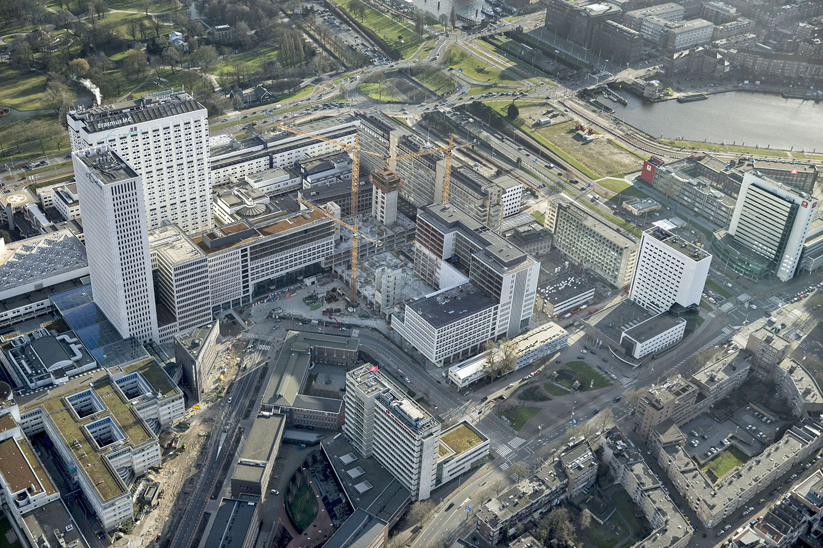

Hyperthermia around the world

Slide 34
Current Status Hyperthermia in Spain
“Spanish Radiation Oncology Society (SEOR) working group for Hyperthermic Oncology”
SEOR´s approved: February 2.015
Coordinator: Dr. Jorge Contreras (H. Regional de Málaga)
Members: around 80
Agreement with: Medical Physicist Spanish society SEFM (D. Felix Navarro)
Promoter: Magna Medic Systems/Aplicaciones Tecnológicas/Anatge
Notes:
34

Slide 35
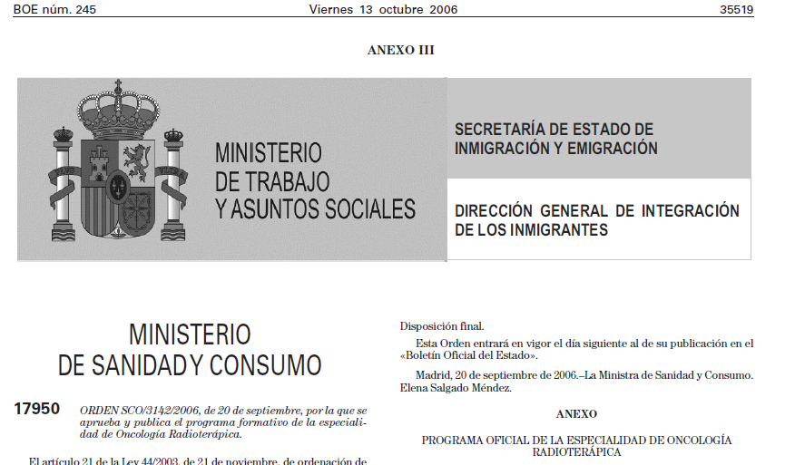

Current Status Hyperthermia in Spain
Notes:
35

Slide 36

Current Status Hyperthermia in Spain
  www.hipertermiaoncologica.es

Slide 37
Current Status Hyperthermia in Spain

Slide 38
Current Status Hyperthermia in Spain
Notes:
38

Slide 39
AGENDA
Nanoparticles in oncology

Slide 40

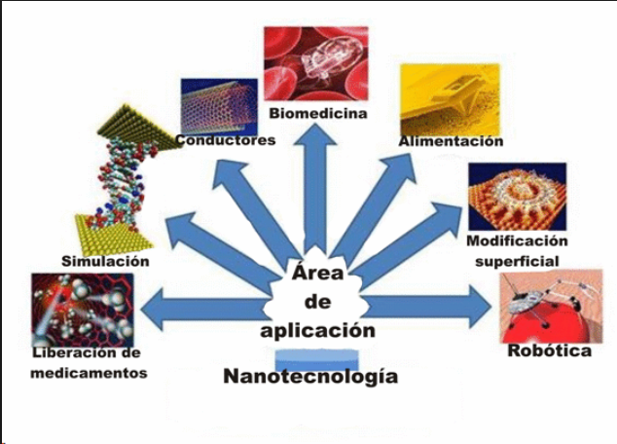
La nanotecnología …..¿Qué es?
Es un campo de la ciencia dedicado al control y manipulación de la materia a una escala menor a un nanómetro, 10⁻⁹m (nm)
Tamaño similar a átomos y moléculas
Aplicaciones diferentes:

Slide 41
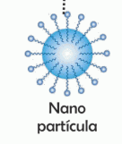
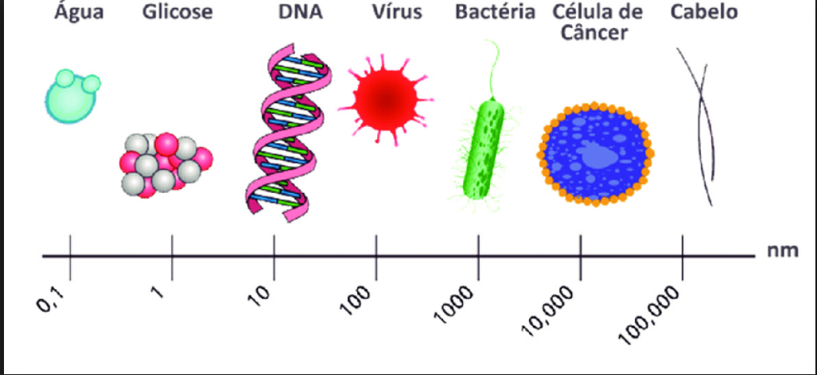
La nanomedicina ….
Es la aplicación de la nanotecnología a las ciencias de la salud
¿En qué áreas?
Nanodiagnóstico
Nanoterapia
Medicina regenerativa

Slide 42
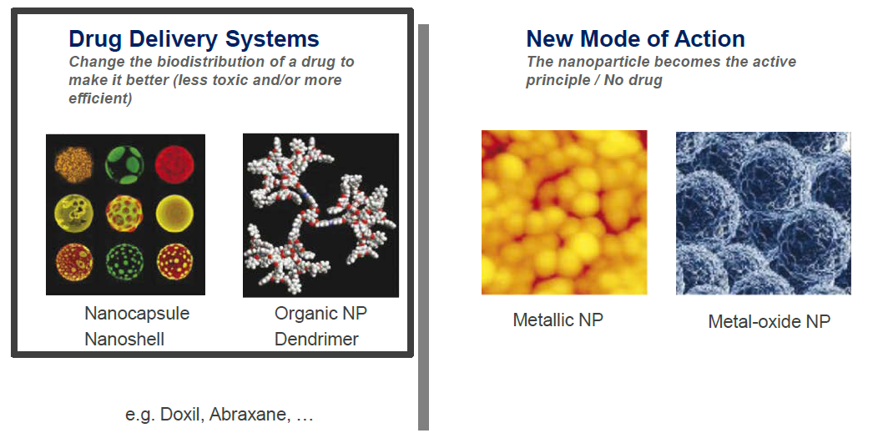
Aplicaciones terapéuticas
Transporte de sustancias activas
Principio activo

Slide 43
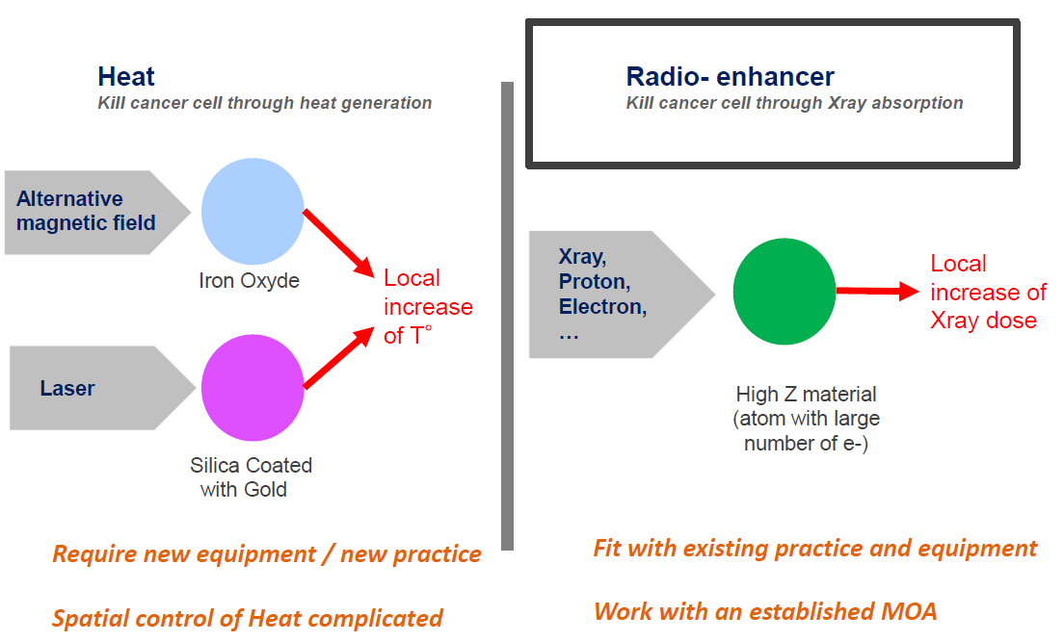
Activación de nanopartículas por mecanismos físicos

Slide 44
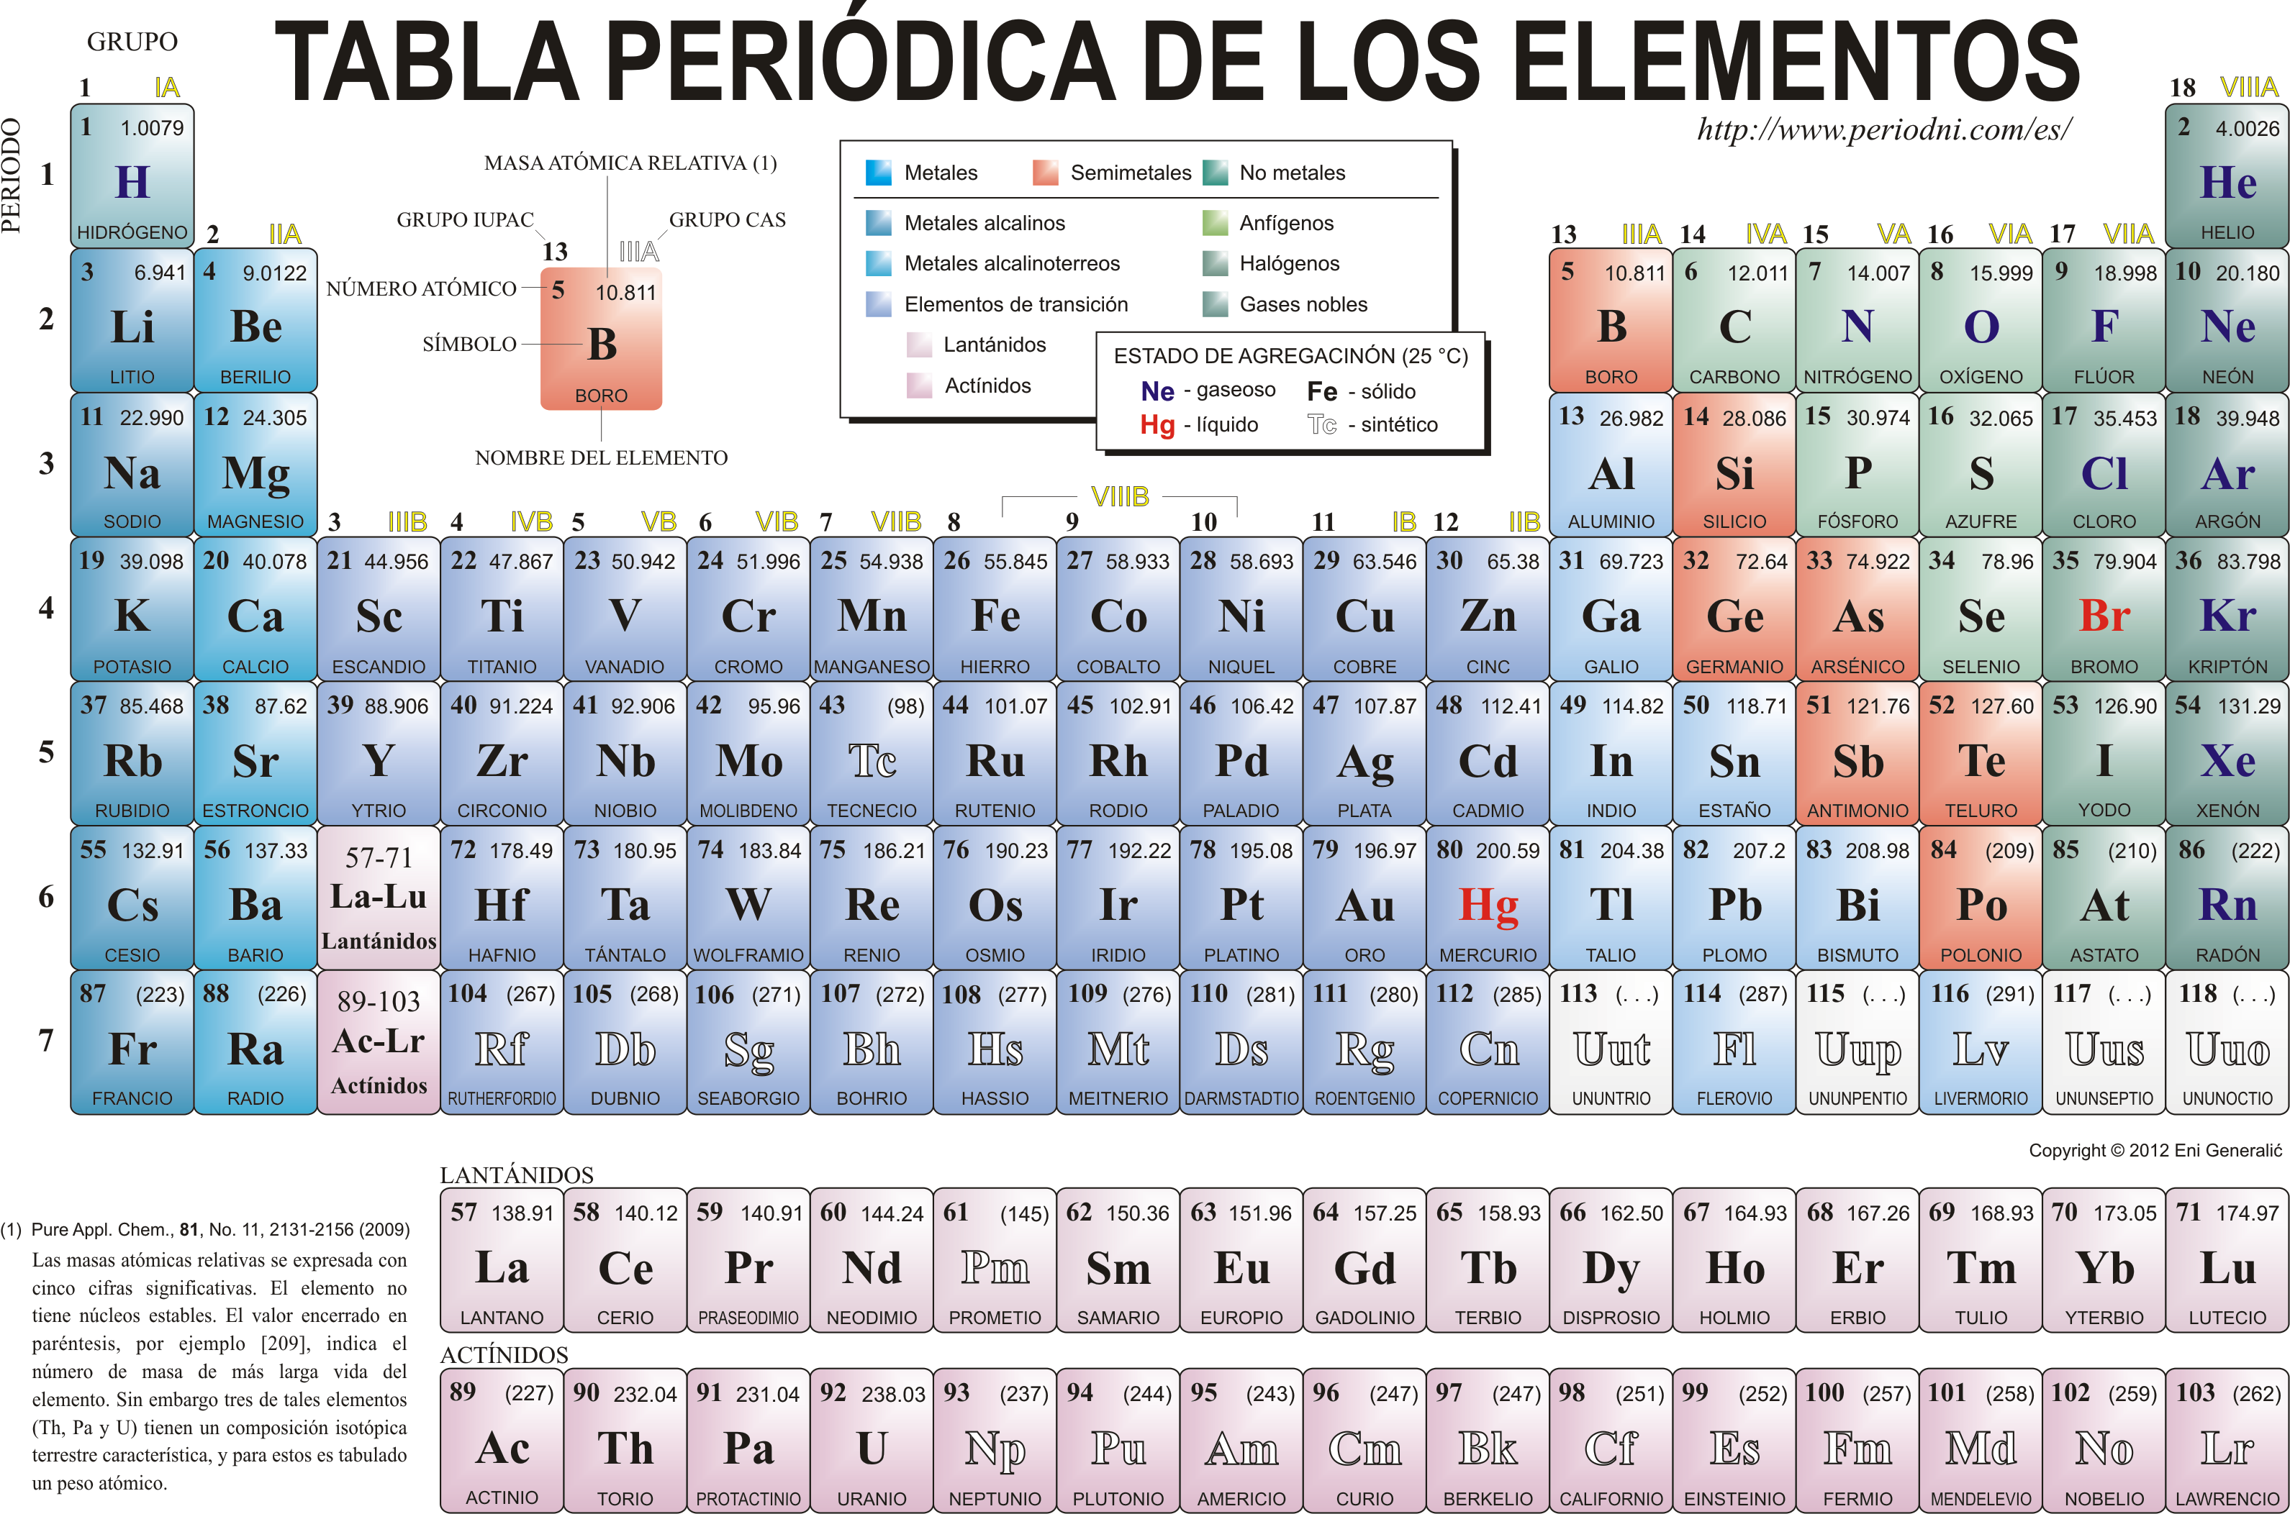
Metales utilizados

Slide 45
Nanopartícula NBTXR3 (óxido de hafnio)

Slide 46
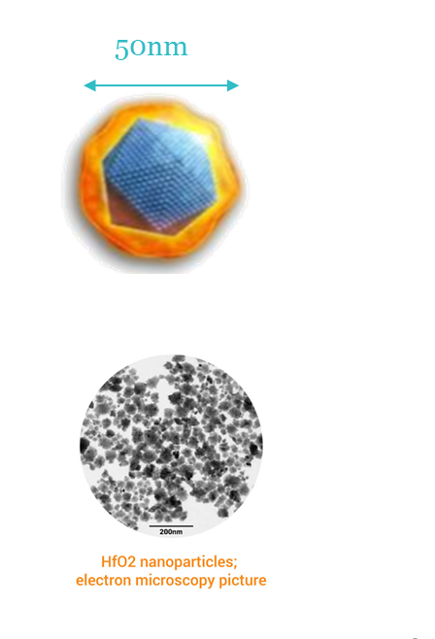
Nanopartícula NBTXR3 (óxido de hafnio)
Inerte a menos que se exponga a radioterapia
Diseñada para entrar en las células tumorales
Mejor relación entre absorción de rayos-X y la seguridad
Aumento de la dosis proveniente del interior de las células cancerosas
No se metaboliza en el hígado
Puede administrarse independientemente de la función hepática o renal

Slide 47
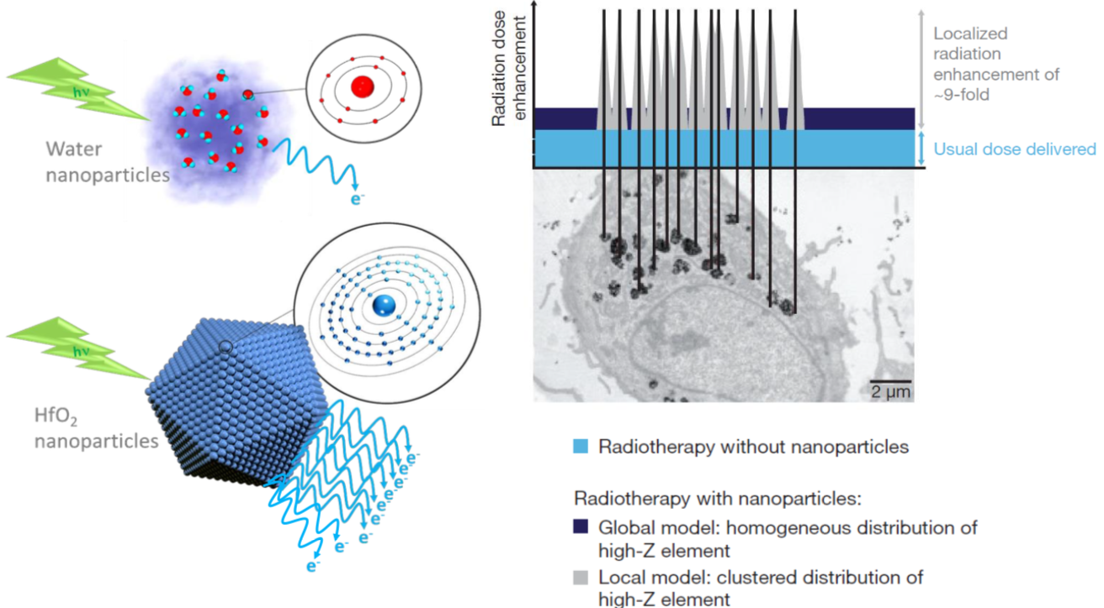
NBTXR3: Modo de acción
NBTXR3 es un gran radiopotenciador
(9 veces la dosis física en la célula tumoral)

Slide 48
NBTXR3 (óxido de hafnio) + Radioterapia
APLICACIONES CLÍNICAS

Slide 49
Desarrollo clínico en Sarcomas de Partes Blandas
Ensayo fase 1
Diseñado para determinar dosis y toxicidad
Publicado en Clinical Cancer Reserach
Ensayo fase 2-3
Estudio aleatorizado, multicéntrico, internacional
Presentado en múltiples congresos
Aceptado para publicación en Lancet Oncology

Slide 50
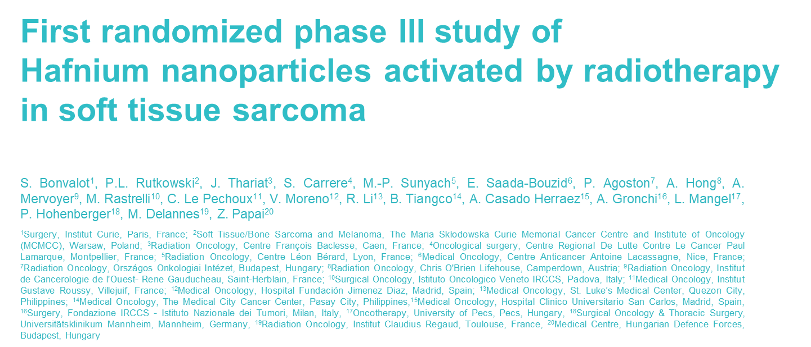
ESTRO 2019. Milan

Slide 51
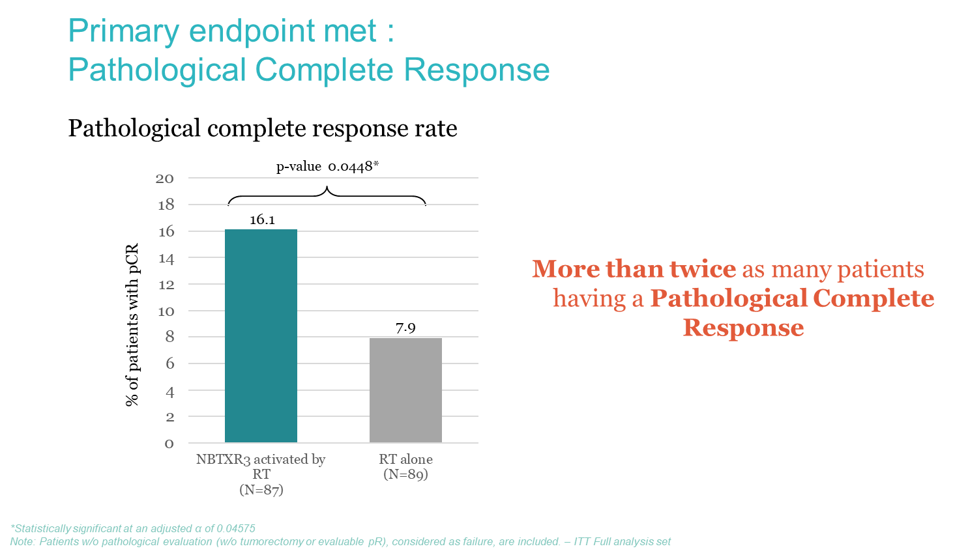

Slide 52
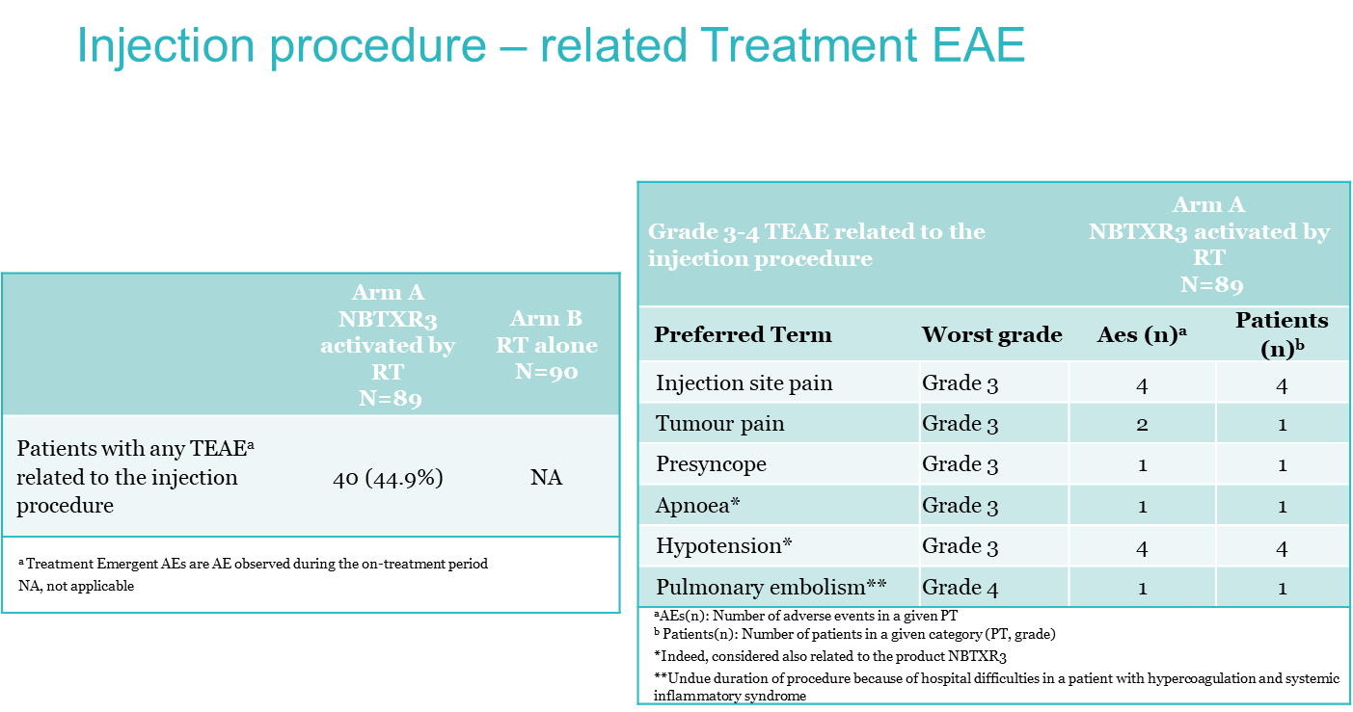

Slide 53
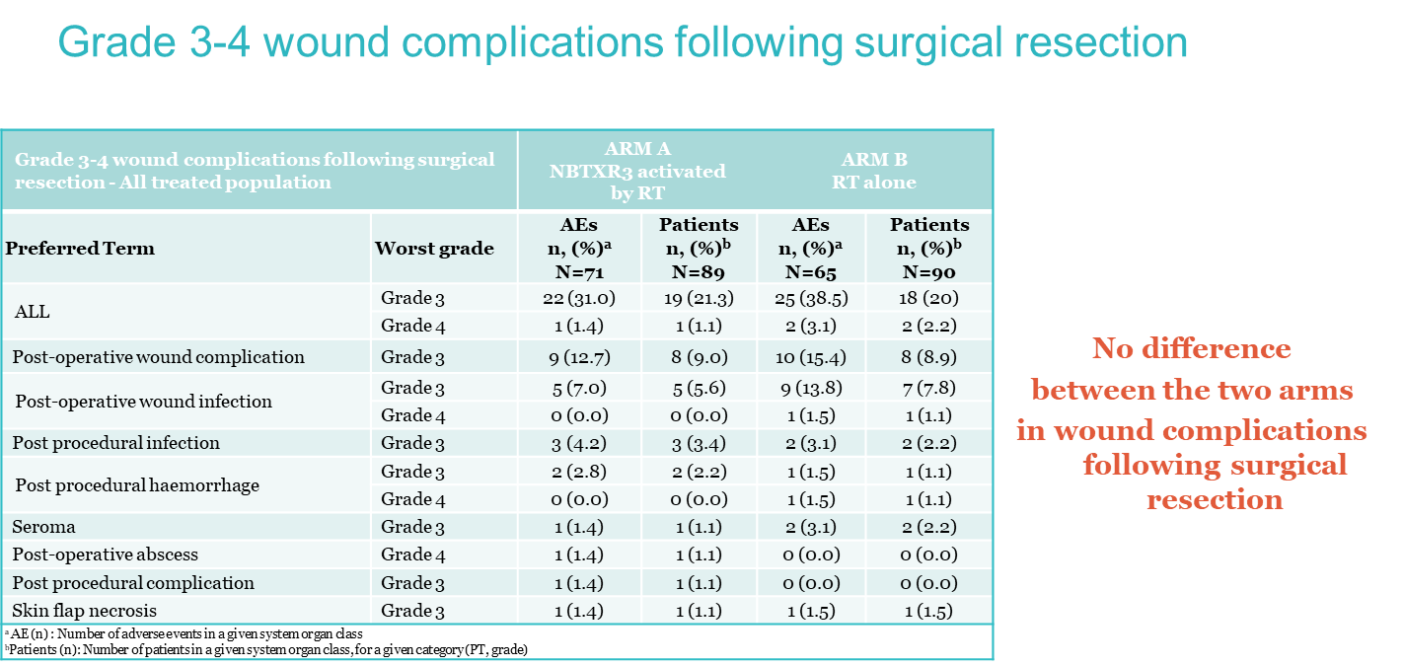

Slide 54
Hensify®(NBTXR3) received European Market Approval (CE mark) enabling commercialization in 27 European Union countries for the treatment of locally advanced soft tissue sarcoma. April 2019

Slide 55
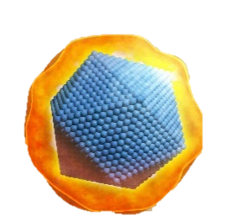
Indication
Preclinical
PI
PII
PIII
Approval
Soft tissue sarcoma
EU / Asia
Head and neck cancer
(Radiotherapy alone)
EU
Liver metastasis
Hepatocellular carcinoma
EU
EU
Prostate cancer
US
Recurrent
Head & Neck
Lung metastasis
Liver metastasis
US
+ Checkpoint Inhibitors
US

Slide 56
Study NBTXR3-102
A PHASE I DOSE-ESCALATION/DOSE EXPANSION STUDY OF NBTXR3 ACTIVATED BY INTENSITY MODULATED RADIATION THERAPY IN PATIENTS WITH LOCALLY ADVANCED SQUAMOUS CELL CARCINOMA OF THE ORAL CAVITY OR OROPHARYNX

Slide 57
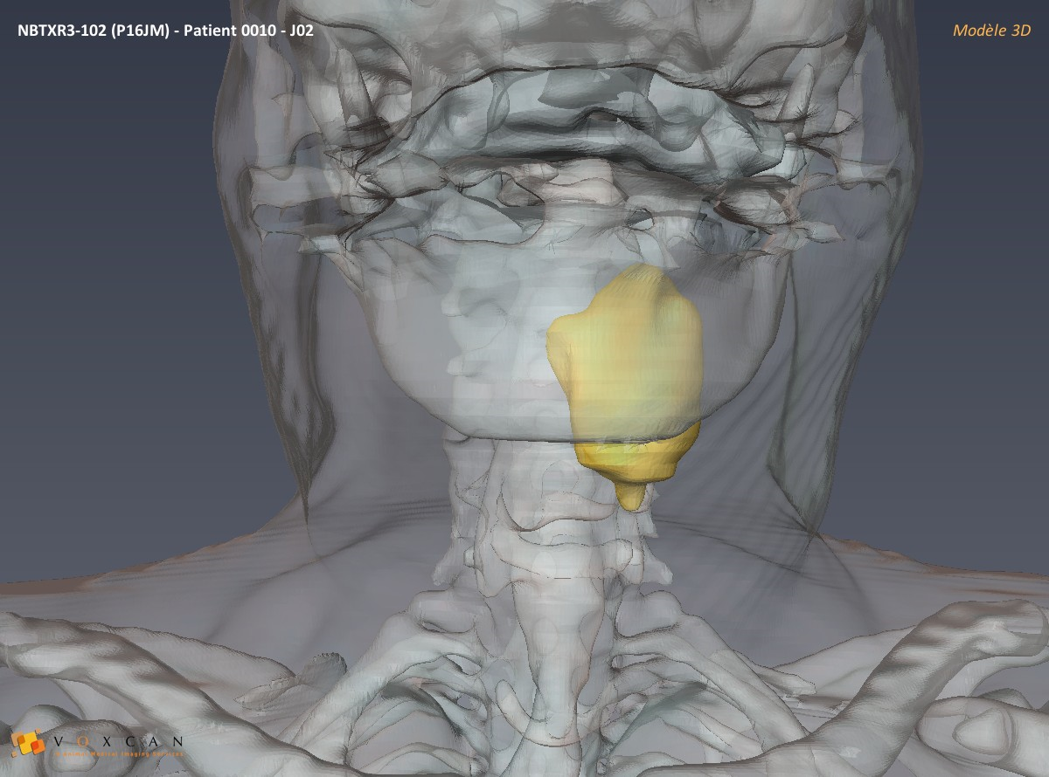
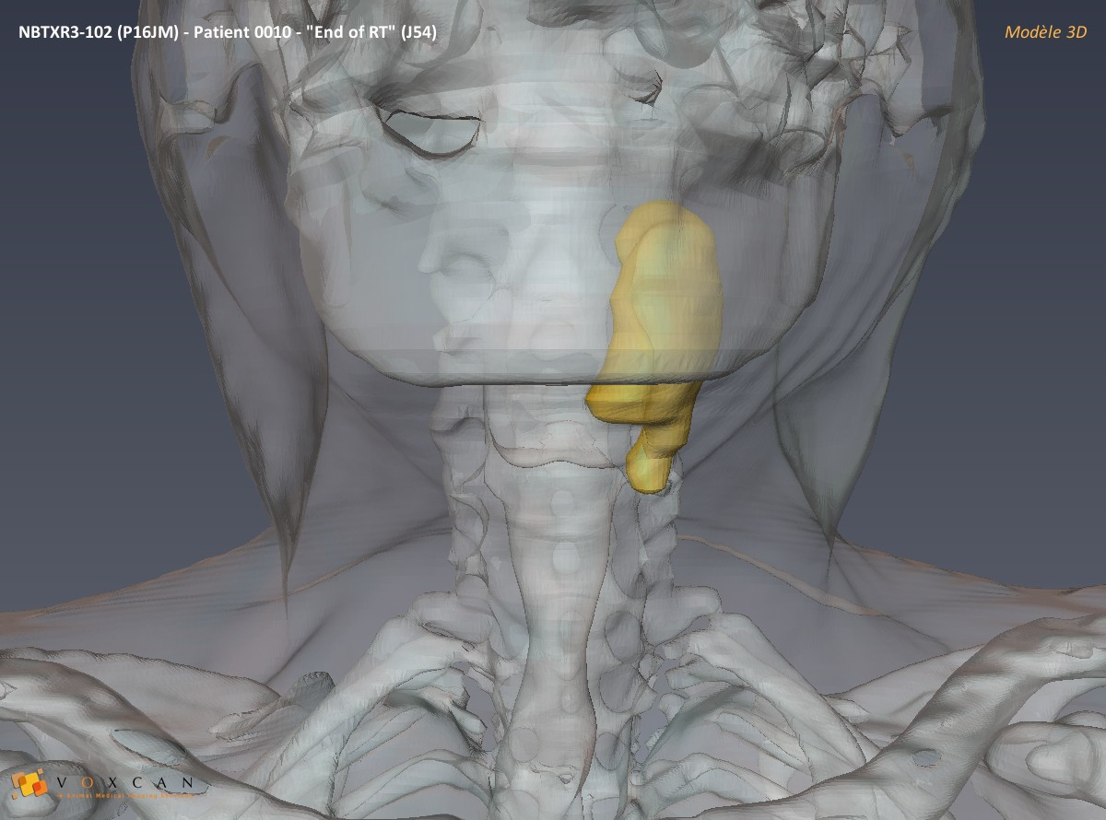
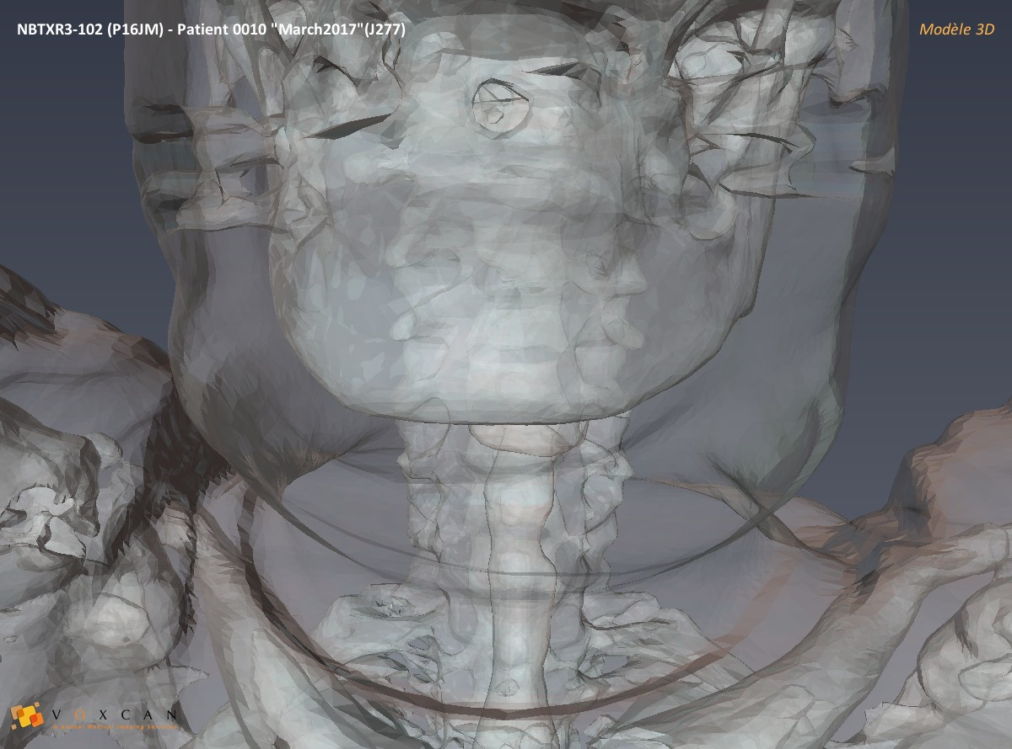
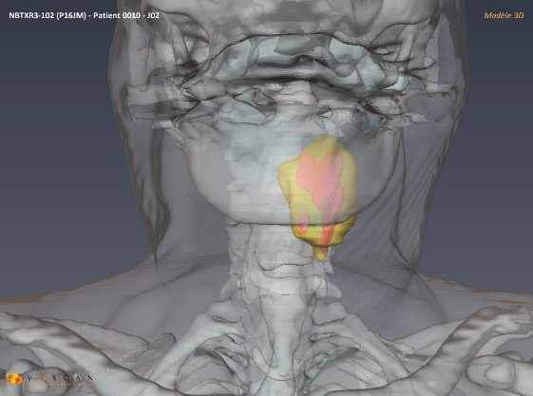


Anti-tumor activity: Complete response visualized via 3-D reconstruction; highlighting localized and Inert NBTXR3
Tumor
Complete response
Tumor
NBTXR3
CT-scan 24h post IT injection
CT-scan 2 months post IT injection
CT-scan 7 months after last RT fraction

Slide 58

Spain
Malaga –3 patients
Notes:
Phase 3 – patients with advanced STS in limbs and trunk walls
Unable to have surgery so they get adjuvant RT pre-operative
N=180 recruited, but 4 did not have STS
--
Inclusion Criteria:
Age: 18 years and older
Soft tissue sarcoma of the extremity or trunk wall, or localized in the posterior region of the neck (i.e., coronal section passing through the posterior limit of the ear)
Locally advanced soft tissue sarcoma,candidate to radiotherapy
Primary tumor or,
Relapsed tumor, localized out of already irradiated area or,
Sarcomas secondary to previous irradiation exposure due to other primary cancer
WHO performance score 0 to 2
Adequate function of Bone marrow:
Adequate renal function
Adequate liver function
All female patients of childbearing potential must have a negative serum/urinary pregnancy test
Exclusion Criteria:
Written Informed Consent not obtained, signed and dated
Patients with the following histological type: Gastrointestinal Stromal Tumors (GIST), embryonal or alveolar rhabdomyosarcoma, Ewing's sarcoma, osteosarcoma or chondrosarcoma, Kaposi's sarcoma, primitive neuroectodermal tumor or dermatofibrosarcoma protuberans
Soft tissue sarcoma of the trunk wall localized in the abdominal region, i.e. the region defined cranially by the xiphoid process of the sternum and the costal margins, and caudally by the line joining the anterior superior iliac spines, both limited by the perpendicular lines crossing both nipples
Angiosarcoma of the trunk wall because of its diffuse frontier
Metastatic disease (CT-scan verification) with survival expectation < 6 months
Concurrent treatment with any other anticancer therapy
Absence of histologically or cytologically proven cancer at the first diagnosis
Previous neoadjuvant chemotherapy treatment given as an upfront of the current treatment line
Previous radiation therapy in relapse site of the soft tissue sarcoma (no radiation re-challenge is permitted)
Moderate and severe liver dysfunction
Hemolytic anemia
Autoimmune disease
Complete initial work up earlier than 4 weeks prior to patient registration
Patients unable to comply with scheduled visits, treatment plans, laboratory tests, and other study procedures.
Patients participating in another clinical investigation at the time of signature of the informed consent.

Slide 59

Treatment of elderly frail HNSCC patients treated by hafnium oxide nanoparticles activated by IMRT (Phase I-II)
Christophe Le Tourneau¹, Valentin Calugaru¹, Victor Moreno Garcia², Xavier Mirabel³, Bernard Doger², Emiliano Calvo², Jacek Fijuth⁴, Tomasz Rutkowski⁵, Nicolas Magné⁶, Katell Bernois⁷ , Mercedes De Rink⁷ ,Edwina Baskin-Bey⁷, Miren Sanz Taberna⁸, Jorge Contreras⁹, Irene Brana¹⁰, Zsuzsanna Papai¹¹, Zoltán Takacsi-Nagy¹², Xavier Liem³, Sébastien Salas¹³, Stéphanie Wong¹², Carmen Florescu¹⁴, Juliette Thariat¹⁴, and Caroline Hoffmann¹
¹Institut Curie, Paris, France; ²START Madrid, Madrid, Spain ; ³Centre Oscar Lambret, Lille, France; ⁴Provita Prolife, Tomaszów Mazowiecki, Poland; ⁵Maria Skłodowska-Curie Institute of Oncology, Gliwice, Poland; ⁶Institut de Cancérologie Lucien Neuwirt, Saint-Priest-en-Jarez, France; ⁷Nanobiotix SA, Paris, France; ⁸Institut Catala d’Oncologia, Barcelona, Spain; ⁹University Regional Hospital of Malaga, Malaga, Spain; ¹⁰Vall d'Hebron University Hospital, Bacelona, Spain; ¹¹Hungarian Defence Forces Military Hospital, Budapest, Hungary; ¹²National Institute of Oncology, Budapest, Hungary; ¹³Hôpital Timone, APHM, Marseille, France; ¹⁴Unicancer - François Baclesse Center, Caen, France

Slide 60

Funded by
Phase III dose escalation and ongoing expansion sites and all staff
Institut Curie, Paris, France
Caroline Hoffmann
José Rodriguez
Thomas Jouffroy
Valentin Calugaru
Anne Chilles
Samar Khrili
Maria Lesnik
Nathalie Badois
Olivier Choussy
Edith Borcoman
Centre Oscar Lambret, Lille, France
Xavier Liem
Xavier Mirabel
Hôpital Timone, Marseille, France
Sébastien Salas
Nicolas Fakhry
Stéphanie Wong
START, Madrid, Spain
Emiliano Calvo
START –FJD, Madrid, Spain
Victor Moreno
Bernard Doger
Institut de Cancérologie Lucien Neuwirt, Saint-Priest-en-Jarez, France
Nicolas Magné
Provita Prolife, Tomaszów Mazowiecki, Poland
Jacek Fijuth
Centre François Baclesse – Uncancer, Caen, France
Carmen Florescu
Juliette Thariat
Hungarian Defence Forces Military Hospital, Budapest, Hungary
Zsuzsanna Papai
Institut Catala d’Oncologia, Barcelona, Spain
Miren Sanz Taberna
Maria Skłodowska-Curie Institute of Oncology, Gliwice, Poland
Tomasz Rutkowski
Krzysztof Skladowski
NU-MED Centrum Diagnostyki I Terapi Onkologicznej Zamosc, Zamosc, Poland
Michal Maslowski
Centrum Onkologii Ziemi Lubelskiej im. Sw. Jan z Dukli, Lublin, Poland
Krzysztof Kupisz
Swietokrzyskie Centrum Onkologii, Dzial Otolaryngologii, Kielce, Poland
Slawomir Okla
University Regional Hospital of Malaga, Malaga, Spain
Jorge Contreras Martinez
Vall d'Hebron University Hospital, Barcelona, Spain
Irene Brana
Elena Garralda Cabanas
National Institute of Oncology, Budapest, Hungary
Zoltán Takacsi-Nagy
Centre Hospitalier Universitaire, Rennes, France
Prof Franck Jegoux
Gustave Roussy, Villejuif, France
France Nguyen Thanh Van
Centre Antoine Lacassagne – IUFC, Nice, France
Gilles Poissonnet

Slide 61
Notes:
New study review shows 9 year survival rates 50% greater when adding hyperthermia

Slide 62
Activación de nanopartículas por mecanismos físicos

Slide 69

Clinical implementation is ongoing, by Magforce (Málaga)

Slide 71
Time for Hyperthermia-Nanoparticles

Slide 72

Time for Hyperthermia-Nanoparticles
Notes:
La red nacional de Nanotecnología en Hipertermia Traslacional HIPERNANO está constituida por 15 nodos, comprendiendo hospitales, centros de investigación y universidades que colaboran en el desarrollo y la investigación de la hipertermia magnética como coadyuvante en el tratamiento del cáncer.

Slide 73
Time for Hyperthermia-Nanoparticles
La combinación de Hipertermia y Nanopartículas (+/- RT) es factible y segura para su utlización en un subgrupo amplio de localizaciones tumorales
La Hipertermia ofrece actualmente mejores resultados clinicos gracias a las avance tecnológicos y equipos disponibles
  Hay un creciente número de paises con disponibilidad de centros para ofrecer estas técnicas, con resultados muy prometedores en situaciones oncológicas con resultados adversos (Tumores del SNC, Sarcomas, CyC, lesiones hepaticas, etc)
Existe una urgente necesidad de regulación legal para poder utilizar e incorporar a nivel asistencial estas técnicas

Slide 74


Time for Hyperthermia-Nanoparticles
- Hyperthermia is a unique oportunity to improve the results of the convencional cancer treatment (Surgery +/- Radiotherapy +/- Chemotherapy)
- But it´s also a big oportunity to make bussines

